Slide 1
Containment Domains A Scalable, Efficient, and Flexible Resilience Scheme for Exascale Systems
Jinsuk Chung, Ikhwan Lee, Michael Sullivan,
Jee Ho Ryoo, Dong Wan Kim, Doe Hyun Yoon+,
Larry Kaplan*, and Mattan Erez
UT Austin, + now at HP Labs, * Cray

Slide 2
Containment Domains A Scalable, Efficient, and Flexible Resilience Scheme for Exascale Systems

Slide 3
Motivation and goals
Resilience bounds performance
Resilience is a major obstacle to exascale
Containment domains: scalable efficient resilience
Hierarchical
Preserve data where most efficient and effective
Proportional
Tunable redundancy and recovery
Different errors/faults handled differently
Abstract
Portable
Amenable to auto-tuning and analysis
CDs elevate resilience to a first-order application concern

Slide 4
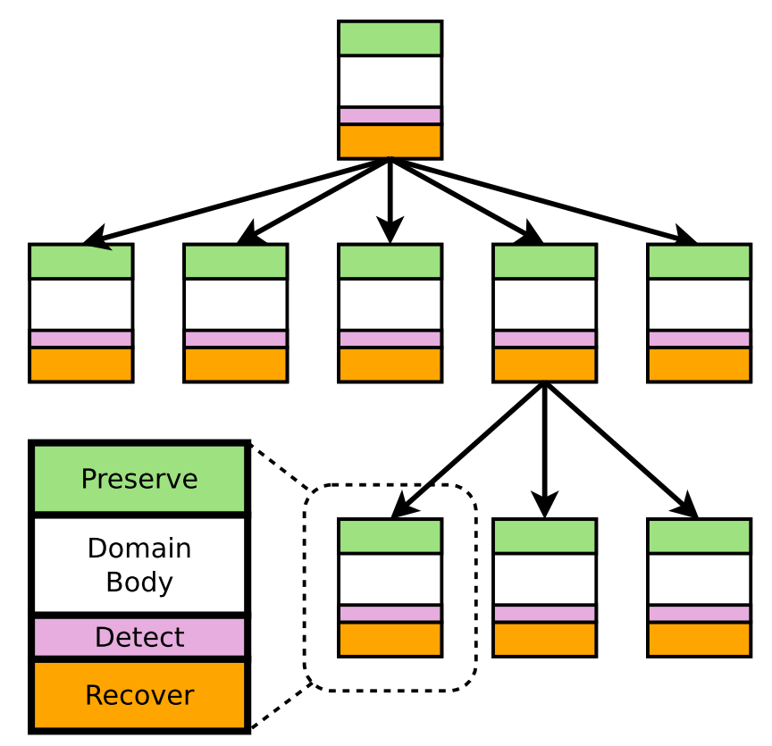
Containment domains
Single consistent abstraction
Encapsulates resilience techniques
Spans levels: programming, system, and analysis
Components
Preserve data on domain start
Compute (domain body)
Detect faults before domain commits
Recover from detected errors
Semantics
Erroneous data never communicated
Each CD provides recovery mechanism
Hierarchy
Escalation
Match CD and machine hierarchies
Root CD
Child CD

Slide 5
Mapping example: SpMV
void task<inner> SpMV( in M, in V_{i}, out R_{i}){
forall(…) reduce(…) SpMV(M[…],V_{i}[…],R_{i}[…]);
}
void task<leaf> SpMV(…){
for r=0..N
for c=rowS[r]..rowS[r+1] { res_{i}[r]+=data[c]*V_{i}[cIdx[c]];
prevC=c;
}
}
$$M$$
$$V$$
Matrix M
Vector V

Slide 6
Mapping example: SpMV
void task<inner> SpMV( in M, in V_{i}, out R_{i}){
forall(…) reduce(…) SpMV(M[…],V_{i}[…],R_{i}[…]);
}
void task<leaf> SpMV(…){
for r=0..N
for c=rowS[r]..rowS[r+1] { res_{i}[r]+=data[c]*V_{i}[cIdx[c]];
prevC=c;
}
}
$$M_{00}$$
$$M_{01}$$
$$V_{0}$$
$$M_{10}$$
$$M_{11}$$
$$V_{1}$$
Matrix M
Vector V

Slide 7
Mapping example: SpMV
void task<inner> SpMV( in M, in V_{i}, out R_{i}){
forall(…) reduce(…) SpMV(M[…],V_{i}[…],R_{i}[…]);
}
void task<leaf> SpMV(…){
for r=0..N
for c=rowS[r]..rowS[r+1] { res_{i}[r]+=data[c]*V_{i}[cIdx[c]];
prevC=c;
}
}
$$M_{00}$$
$$M_{01}$$
$$V_{0}$$
$$M_{10}$$
$$M_{11}$$
$$V_{1}$$
Matrix M
Vector V
Distributed to 4 nodes
$$M_{00}$$
$$V_{0}$$
$$M_{10}$$
$$V_{0}$$
$$M_{01}$$
$$V_{1}$$
$$M_{11}$$
$$V_{1}$$

Slide 8
Mapping example: SpMV
void task<inner> SpMV( in M, in V_{i}, out R_{i}){
forall(…) reduce(…) SpMV(M[…],V_{i}[…],R_{i}[…]);
}
void task<leaf> SpMV(…){
for r=0..N
for c=rowS[r]..rowS[r+1] { res_{i}[r]+=data[c]*V_{i}[cIdx[c]];
prevC=c;
}
}
$$M_{00}$$
$$M_{01}$$
$$V_{0}$$
$$M_{10}$$
$$M_{11}$$
$$V_{1}$$
Matrix M
Vector V
Distributed to 4 nodes

Slide 9
Mapping example: SpMV
Preserve
Preserve (Parent)
Parent CD
M
V
Child
Child
Detect
Child CD
Recover
Detect
Detect
Preserve
Preserve
Preserve
Preserve
Recover
Recover
$$M_{00}$$
$$V_{0}$$
$$M_{10}$$
$$V_{0}$$
$$M_{01}$$
$$V_{1}$$
$$M_{11}$$
$$V_{1}$$
Child
Child
Detect
Detect
Detect
Detect
Detect
Detect
Recover
Recover
Recover
Recover
Recover
Recover
Detect (Parent)
Recover (Parent)

Slide 10
Initial CD preservation API and prototype
void task<inner> SpMV(in M, in V_{i}, out R_{i}) {
cd = create_CD(parentCD);
preserve_via_copy(cd, matrix, …);
forall(…) reduce(…) SpMV(M[…],V_{i}[…],R_{i}[…]);
commit_CD(cd);
}
void task<leaf> SpMV(…) {
cd = create_CD(parentCD);
preserve_via_copy(cd, matrix, …);
preserve_via_parent(cd, vec_{i}, …);
for r=0..N
for c=rowS[r]..rowS[r+1] { res_{i}[r]+=data[c]*V_{i}[cIdx[c]];
check {fault<fail>(c > prevC);}
prevC=c;
}
commit_CD(cd);
}
API
create_CD
preserve_via_copy
preserve_via_parent
check
commit_CD
Preservation components prototype on Cray XK7
http://lph.ece.utexas.edu/public/CDs

Slide 11
Containment domains long-term design
int main(int argc, char **argv)
{
main_task here = phalanx::initialize(argc, argv);
… Create test arrays here …
// Launch kernel on default CPU (“host”)
openmp_event e1 = async(here, here.processor(), n)
(host_saxpy, 2.0f, host_x, host_y);
// Launch kernel on default GPU (“device”)
cuda_event e2 = async(here, here.cuda_gpu(0), n)
(device_saxpy, 2.0f, device_x, device_y);
wait(here, e1&e2);
return 0; }
Language integration
Compiler support
Runtime components
Hardware aspects
CD Annotations
resilience model
efficiency-oriented programming model
CD API
resilience interface
Research prototype by Cray for XK7 (Titan)
Runtime Library Interface
CD control and persistence
Hardware Abstraction Layer
Error Reporting Architecture
Machine
ECC, status

Slide 12
Outline
Motivation and Goals
Semantics of Containment Domains
What do CDs do? When and why are they good?
Differentiated error handling
Analyzability
Evaluation

Slide 13
Differentiated Error Handling

Slide 14
State preservation and restoration
Abstract
Optimized preservation and restoration
Analyzed, auto-tuned
Allows explicit application control
Hierarchical
Match storage hierarchy
Maximize locality and minimize overhead
Partial
Preserve only when worth it
Exploit natural redundancy
Exploit hierarchy
Enable regeneration

Slide 15
SpMV partial preservation tuning
$$M_{00}$$
$$M_{01}$$
$$V_{0}$$
void task<leaf> SpMV(…) {
cd = create_CD(parentCD);
preserve_via_copy(cd, matrix, …);
preserve_via_parent(cd, vec_{i}, …);
for r=0..N
for c=rowS[r]..rowS[r+1] { res_{i}[r]+=data[c]*V_{i}[cIdx[c]];
check {fault<fail>(c > prevC);}
prevC=c;
}
commit_CD(cd);
}
$$M_{10}$$
$$M_{11}$$
$$V_{1}$$
Hierarchy
Matrix M
Vector V
$$M_{00}$$
$$V_{0}$$
$$M_{10}$$
$$V_{0}$$
$$M_{01}$$
$$V_{1}$$
$$M_{11}$$
$$V_{1}$$
Natural redundancy

Slide 16
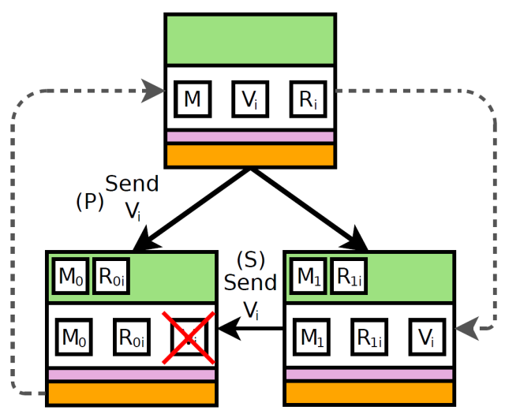
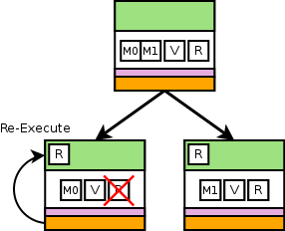
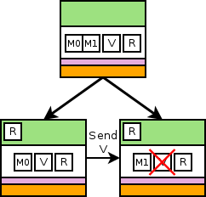
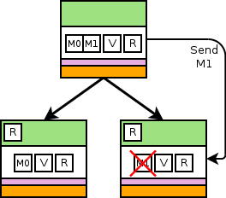
Concise abstraction for complex behavior
void task<leaf> SpMV(…) {
cd = create_CD(parentCD);
preserve_via_copy(cd, matrix, …);
preserve_via_parent(cd, vec_{i}, …);
for r=0..N
for c=rowS[r]..rowS[r+1] { res_{i}[r]+=data[c]*V_{i}[cIdx[c]];
check {fault<fail>(c > prevC);}
prevC=c;
}
commit_CD(cd);}
Local copy or regen
Sibling
Parent (unchanged)

Slide 17
Detection
Abstract
Utilize most efficient detection mechanism
Low overhead detection: e.g., algorithm specific detection
Customized
Replicate in time, replicate in space, algorithm specific
Heterogeneous
Per-CD routines
E.g., selective multi-granularity DMR

Slide 18
Recovery
Abstract
Utilize most efficient recovery mechanism
Maximize local recovery
Low overhead recovery e.g., re-materialization or regeneration
Customized
Re-execute, ignore, re-materialize, DMR, TMR
Heterogeneous
Per-CD routines
E.g., selective multi- granularity DMR
App/system specific
Compute
Preserve
Detect
Time
Re-execution overhead

Slide 19
Analyzability

Slide 20
Analytical Model
Leverage hierarchy and CD semantics
Uncoordinated “local” actions
Solve in → out
Application abstracted to CDs
CD tree
Volumes of preservation, computation, and communication
Preservation and recovery options per CD
Machine model
Storage hierarchy
Communication hierarchy
Bandwidths and capacities
Error processes and rates
Execution time

Slide 21
Power model
CDs that are not re-executing may remain idle
Actively executing a CD has a relative power of 1
A node that is idling consumes a relative power of $α$
In our experiments $α=0.25$
Parallel domains
Re-execution time
Idle
Idle
Idle
Idle
Idle
Idle
Idle
Idle
Idle
Idle
Idle
Idle
Idle
Idle
Idle
Idle
Execution
Re-execution

Slide 22
Evaluation
What we evaluated
Performance efficiency
Energy overhead
Baseline resiliency approaches
g-CPR: global checkpoint restart
h-CPR: hierarchical checkpoint restart (e.g., SCR)
Optimum interval used for each
CD advantages
Preserve only what is needed
Hierarchical uncoordinated
Assumptions
Detection overhead is assumed to be zero
Capacity of storage for preservation is infinite
Infinite spares (quick repair)

Slide 23
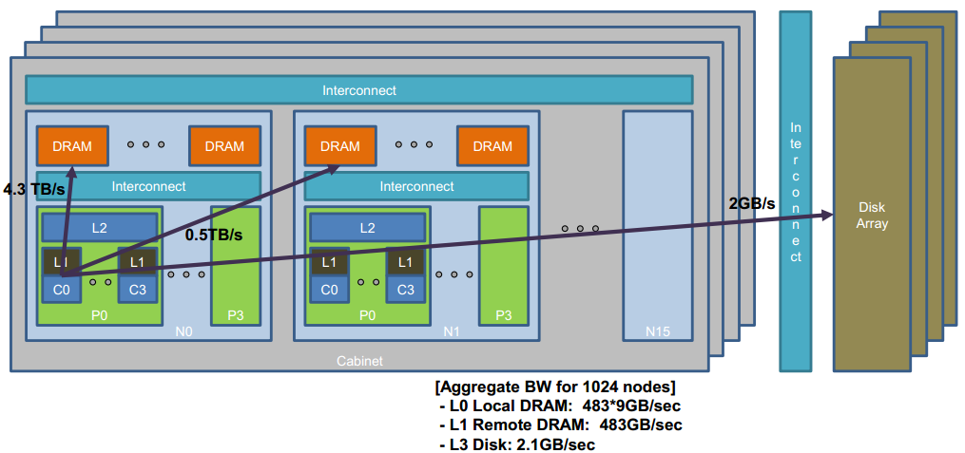
Machine and error models
Component | “Performance” | Error | Error Scaling
Core | 10GFLOP/core | Soft error | ∝ #cores
Memory | 1GB/core | ECC fail | ∝ #DRAM chips
Socket | 200GB/s /socket | Hard/OS crash | ∝ #sockets
System | Hierarchical network | Power module or network | ∝ #modules and #cabinets

Slide 24
Workloads
Monte Carlo NT
Embarrassingly parallel
Infrequent communication
Small fraction of read/write data
Iterative hierarchical SpMV
Recursive decomposition
Natural redundancy
Frequent global communication
Mantevo HPCCG
Requires little storage
Conjugate-gradient based linear system solver
Frequent global communication

Slide 25
Evaluation tools
Simulator
Executes at granularity of containment domains
Reexecutes when error is detected
Used to validate the analytical model
Analytical Model
Simulation is too slow for evaluating exascale systems
Inputs to the model: extracted from each application
Volume of preservation, restoration, computation and communication
Error rates
Shape of CD structure
Validation
Simulator and analytical model
Prototype of preservation/restoration on Cray XK7

Slide 26
Autotuned CDs perform well
NT
SpMV
HPCCG
Peak System Performance

Slide 27
Autotuned CDs perform well
NT
SpMV
HPCCG
Peak System Performance

Slide 28
SPMV, HPCCG: local recovery and partial preservation
Disk
Remote NVM
Local NVM
DRAM
Partial preservation via sibling or parent where appropriate

Slide 29
NT: hierarchical local recovery and partial preservation
Disk
Remote NVM
Local NVM
DRAM
Partial preservation via sibling, parent, or regeneration where appropriate

Slide 30
Autotuned CDs perform well
NT
SpMV
HPCCG
Peak System Performance

Slide 31
CDs improve energy efficiency at scale
NT
SpMV
HPCCG
Peak System Performance

Slide 32
CDs improve energy efficiency at scale
NT
SpMV
HPCCG
Peak System Performance

Slide 33
10X failure rate emphasizes CD benefits
Energy Overhead
Peak Performance

Slide 34
More in the paper
Strict vs. relaxed containment domains
Analytical model details
Error and machine model details
Additional sensitivity studies
Related work discussion

Slide 35
Conclusion
Containment domains
Abstract constructs for resilience concerns & techniques
Proportional and application/machine tuned resilience
Hierarchical & distributed preservation, restoration, and recovery
Analyzable and amendable to automatic optimization
Scalable to large systems with high relative energy efficiency
Heterogeneous to match emerging architecture
Good start and exciting work ahead
Preservation concept prototyped on Cray XK7
Fine-grained CDs for high error rates
Compiler optimizations and support
Application-specific detection/elision
PGAS support and interactions with system
Interaction with other models (tasking, DSLs, …)
http://lph.ece.utexas.edu/public/CDs

Slide 36
Questions?
Thank you

