Slide 1
A brief introduction to
Memory system proportionality and resilience
Mattan Erez
The University of Texas at Austin

Slide 2

With support from
  NSF Award #0954107

Slide 3
The constraints:
  Power/energy
  Time
  Money
  Correctness

Slide 4
Can’t work harder –
have to work smarter

Slide 5
Can’t work harder –
have to work smarter
Efficient & Proportional

Slide 6
Multiple constraints and needs →
Heterogeneity
asymmetry
specialization

Slide 7
big.LITTLE and per core DvFS
  Static and dynamic asymmetry
Accelerators
  Programmable and fixed-function

Slide 8
Throughput cores
Latency cores
Specialized cores
  → proportionality of compute

Slide 9
Great, we solved the easy part: proportional compute

Slide 10
Programming is hard
Memory is hard

Slide 11
The memory challenge (outline)
  Why do memory systems look the way they do?
    Efficiency and reliability
    Abstractions for architects
  Role of heterogeneity and programs
  Some interesting mechanisms
  Where do we go from here?

Slide 12
Storage device options abound
  SRAM
  DRAM
  FLASH
  STT-/M- RAM
  PCM, Memristor, RRAM, …

Slide 13
Architects should think in abstractions
  Research should be general

Slide 14
The fundamentals
Cheap
Energy efficient
High capacity
Low latency
High throughput
Reliable

Slide 15
Memory must be cheap
  Memory is already too expensive
    15 – 50% of system cost (or more)
  But, margins razor thin (commodity)
Notes:
Processor vendors like it that way
Customers seem to as well

Slide 16
Memory must be energy efficient
  Memory accounts for 15 – 60+%
  of “compute” energy and getting worse
    More capacity
    Proportional compute

Slide 17
Memory must be high capacity
  Memory footprints keep growing
    More interesting data
    More data
    More specialized data structures

Slide 18
Memory must be high capacity
Many chips

Slide 19
Memory must be high capacity
Many chips
Denser mem,
Fewer chips

Slide 20
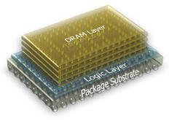
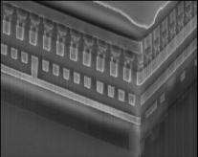
Memory must be high capacity
Many chips
Denser mem,
Fewer chips
Many dice,
Fewer chips
© Micron

Slide 21
Memory composed of
  Multiple modules
  Each module with N >=1 components
  Lots of cells per component
  Each cell >= 1 bit

Slide 22
Memory should be low latency
  Latency == performance
  Except when sufficient concurrency

Slide 23
Low latency conflicts with
  Cheap
  Capacity
  Sometimes with
    Throughput
    Energy
    Reliability

Slide 24
Latency components:
  Memory cell access
  Data transfer
  Queuing

Slide 25
Latency impacted by cell access
denser/efficient → higher latency
  Small cells → sensitive circuits → slow reads
  Writes even more complicated
+ latency
– density
– cost
– energy
– latency
+ density
+ cost
+ energy

Slide 26
Caching to the rescue
  Store some data somewhere fast

Slide 27
Short distances improve latency
  It’s all about the wires

Slide 28
Short distances improve latency
  It’s all about the wires
+ latency
+ energy
– latency
– energy

Slide 29
Short distances improve latency
  It’s all about the wires
+ latency
+ energy
– capacity
– latency
– energy
+ capacity

Slide 30
Hierarchy to the rescue

Slide 31
Hierarchy to the rescue
Processor

Slide 32
Hierarchy to the rescue
Processor

Slide 33
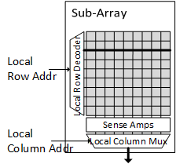
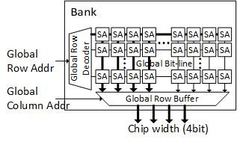
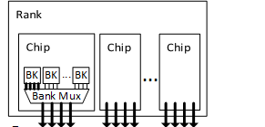
Memory system
  Modules, packages, components
  Arranged in a hierarchy
Each memory component
  Has hierarchy
  Has caching/buffering

Slide 34
Latency impacted by queuing

Slide 35
Deep queues improve locality
  Higher throughput
  Higher efficiency
  Often hurts latency

Slide 36
Memory must be high throughput
  More and more latency hiding

Slide 37
Memory must be high throughput
Many chips
Fewer chips
  High capacity per pin requires efficient access

Slide 38
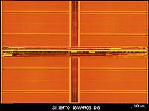
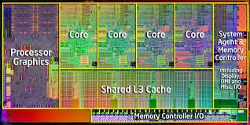
Packaging/interfaces improve throughput
  3D integration
  Limited capacity
Silicon
Interposer
TSV

Slide 39
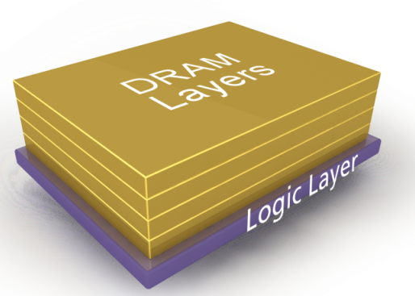
Packaging/interfaces improve throughput
  3D integration
  Limited capacity
  More hierarchy levels
Silicon
Interposer
TSV
  Heterogeneity!

Slide 40
Latency + throughput + efficiency
→ parallelism

Slide 41
Latency + throughput + efficiency
→ parallelism
Access cell

Slide 42
Latency + throughput + efficiency
→ parallelism
Many pins
in parallel
Access many cells in parallel

Slide 43
Latency + throughput + efficiency
→ parallelism
Many pins
in parallel over
multiple cycles
Access even more cells in parallel

Slide 44
Latency + throughput + efficiency
→ parallelism
Many pins
in parallel over
multiple cycles
Access even more cells in parallel

Slide 45
To recap
  Locality
  Hierarchy
  Parallelism

Slide 46
Memory must be reliable
  Written data must be recalled “correctly”

Slide 47
Reliability challenges
  “Natural” change in cell value
  Induced change in cell value
  Read errors
  Write errors
  Wearout and defects

Slide 48
Natural causes of value change
Probability correct
Time
Decay
  Refresh
Notes:
Natural change in state
Decay
DRAM leakage (refresh)
PCM, Memristor, RRAM drift
Flips
DRAM/SRAM/latch particle strikes
STT MRAM state flips
Control
Control-related soft errors corrupt values

Slide 49
Natural causes of value change
Probability correct
Probability correct
Time
Time
Decay
  Refresh
Flip
  ECC + scrub
Notes:
Natural change in state
Decay
DRAM leakage (refresh)
PCM, Memristor, RRAM drift
Flips
DRAM/SRAM/latch particle strikes
STT MRAM state flips
Control
Control-related soft errors corrupt values

Slide 50
Natural causes of value change
Probability correct
Probability correct
Time
Time
Decay
  Refresh / scrub
Flip
  ECC + scrub

Slide 51
Natural causes of value change
Probability correct
Probability correct
Time
Time
Decay
  Refresh / scrub
Flip
  ECC + scrub
  Retention control
    Less dense
    Writes slower/higher-energy
    Can use different devices
Notes:
Natural change in state
Decay
DRAM leakage (refresh)
PCM, Memristor, RRAM drift
Flips
DRAM/SRAM/latch particle strikes
STT MRAM state flips
Control
Control-related soft errors corrupt values

Slide 52
Induced change in value
  Writing or reading disturbs nearby cells
  Worse for writes
  Technology and design dependent

Slide 53
Read errors
  Because of small margins for efficiency

Slide 54
Write errors
  Writing implies changing a state or value
  Stochastic
Probability correct
Time

Slide 55
Write errors
  Writing implies changing a state or value
  Stochastic
  Waiting inefficient and slow
  Write error control conflicts w/ other errors
Probability correct
Time

Slide 56
Wearout and defects
Probability correct
Probability correct
Time
Time
Probability correct
Probability correct
Time
Time

Slide 57
Wearout and defects
  Sparing
  Extra margins
  Retirement
  Compensation (ECC)

Slide 58
Summary: no “good” memory
  It’s all about tradeoffs

Slide 59
Example: DRAM
  Efficient and reliable reads and writes
  Leaky
  Density problematic
  Fairly fast reads and writes
  Parallelism determined by cost
  Fast decay (short retention)
    High variability
  Rare, but important flips
  Very rare disturbs
  Slow wearout

Slide 60
Example: FLASH
  High-energy writes
  Very dense
  Slow reads
  Very slow writes
  Parallelism determined by technology
  Very slow decay (good retention)
  Flips only on periphery
  Write disturbs problematic
  Fast wearout

Slide 61
Example: PCM
  High-energy writes
  Dense
  Fast reads
  Fast-ish writes
  Parallelism determined by cost
  Slow decay (OK retention)
  Flips only on periphery
  Write disturbs problematic
  Fast wearout

Slide 62
Summary of heterogeneity:
interrelated tradeoffs
  Efficiency
  Capacity
  Latency
  Bandwidth
  Parallelism (granularity)
  Reliability

Slide 63
The role of
heterogeneous processors
heterogeneous applications

Slide 64
Proportional compute
  Latency oriented
  Throughput oriented
  Specialized

Slide 65
Application characteristics
  Latency sensitive
  Bandwidth sensitive
  Few tasks or many tasks

Slide 66
Application compute styles
  Batch
  Realtime
  Response time

Slide 67
Application data usage
  Capacity
  Locality
  Precision
  Persistence

Slide 68
Memory must be heterogeneous
but illusion of homogeneity is nice

Slide 69
The solution:
Adaptive proportional memory systems

Slide 70
The solution:
Adaptive proportional memory systems

Slide 71
Adaptive reliability

Slide 72
Adaptive reliability
  Adapt the mechanism
  Adapt the error rate
    precision (stochastic precision)

Slide 73
Adaptive reliability
  By type
    Application guided
  By location (83)
    Machine-state guided

Slide 74
Example: Virtualized ECC
  Adapt the mechanism

Slide 75
Virtual Address space
Physical Memory
Protection Level
Virtual page – x
Page frame – x
Low
Virtual Page to Physical Frame mapping
Virtual page – y
Page frame – y
Medium
Virtual page – z
Page frame – z
High
Data
ECC

Slide 76
Virtual Address space
Physical Memory
Protection Level
Virtual page – x
Page frame – x
Low
Virtual Page to Physical Frame mapping
Virtual page – y
Page frame – y
Medium
Virtual page – z
Page frame – z
High
ECC
ECC page – y
ECC page – z
Physical Frame to ECC Page mapping
Stronger
ECC
Data

Slide 77
Virtual Address space
Physical Memory
Protection Level
Virtual page – x
Page frame – x
Low
Virtual Page to Physical Frame mapping
Virtual page – y
Page frame – y
Medium
Virtual page – z
Page frame – z
High
T2EC for Chipkill
ECC page – y
ECC page – z
Physical Frame to ECC Page mapping
T2EC for
Double
Chipkill
Data
T1EC

Slide 78
Two-Tiered ECC

Slide 80
Caching work great
Normalized Execution Time

Slide 81
Bonus: flexibility of ECC
Normalized Energy-Delay Product

Slide 82
Example: FREE-p
  Adapt to wearout state

Slide 83
FREE-p insights:
  Wearout is gradual
  Adapt ECC strength to wearout degree
  Limit ECC need with adaptive repair
    Retire and remap

Slide 84
Adapt ECC strength
  Multi-tiered ECC

Slide 85
Different cells need different protection

Slide 86
Fine-grain retirement is key

Slide 87
Adaptive FG repair
Page for remapping
D/P flag
Data page
ptr
data

Slide 88
Impact of repair and remap is gradual

Slide 89
Adaptive granularity (parallelism)

Slide 90
Applications have diverse locality
Low spatial locality
~50% is referenced
High spatial locality
1~2
3~6
7~8

Slide 91
Coarse- or fine-grained memory access?
CG-Only: Wide DRAM channel
FG-Only: Many narrow channels

Slide 92
Coarse- or fine-grained memory access?
CG
C
Data
ECC
FG
C0
C1
C2
C3
C4
C5
C6
C7
D0
E0
D1
E1
D2
E2
D3
E3
D4
E4
D5
E5
D6
E6
D7
E7
CG
C
Data
ECC
FG
C0
D0
E0

Slide 93
Dynamically adapt granularity
→ best of both worlds
Locality Predictor
Processor
Core
SLP
$D
$I
Sector cache
(8 8B sectors per line)
L2
Core
0
Core
1
…
Core
N-1
Last Level Cache
Co-scheduling CG/FG w/ split CG
MC
Sub-Ranked DRAM w/ 2X ABUS
Support both CG and FG
DRAM

Slide 94
Subranked memory
  Adapt parallelism
ABUS
DBUS
x8
x8
x8
x8
x8
x8
x8
x8
x8
SR0
SR1
SR2
SR3
SR4
SR5
SR6
SR7
SR8
Reg/Demux

Slide 95
Sectored caches
  Track granularity
Long cache line
tag
D
V
data
Short cache line
tag
D
V
data
Sector cache
tag
D
V
sector 0
D
V
sector 1
D
V
sector 2
D
V
sector 3

Slide 96
Granularity information?
  Application provided (when allocated)
  System learned (when accessed)

Slide 97
Dynamically adapt granularity
PROPORTIONALITY
CG+ECC
FG+ECC
AG+ECC

Slide 98
Memory is heterogeneous
Applications are heterogeneous
this is a good thing

Slide 99
Adaptivity is key

Slide 100
Sometimes need application help
  Programming models and analyses crucial

Slide 101
Think abstractions rather than examples

Slide 102
Memory is heterogeneous
Applications are heterogeneous
this is a good thing
Adaptivity is key
Sometimes need application help
  Programming models and analyses crucial
Think abstractions rather than examples

