Slide 1
Toward Exascale Resilience Part 1: Overview of challenges and trends
Mattan Erez
The University of Texas at Austin
July 2015

Slide 2
With support from
DOE
NSF

Slide 3
Bottom line:
System Complexity increasing
faster than
component reliability improves
No “right” answer
Notes:
Overview of extreme scale resilience and trends
System architecture and components (hardware and software)
Taxonomy of reliability and resilience
Detection -> Containment -> Repair
Forward and backward recovery
Fault modes and models
Error models and Failure models
Memory and networks
Past, present, and near future approaches
Checkpoint restart (classic and improvements)
Impact of level of paranoia
Why supercomputers aren't clouds and what can be learned
Hardware techniques
Containment domains and other Cross-level approaches

Slide 4
An exascale system is a high-performance system for solving big problems

Slide 5
An exascale system is a high-performance system for solving big cohesive problems

Slide 6
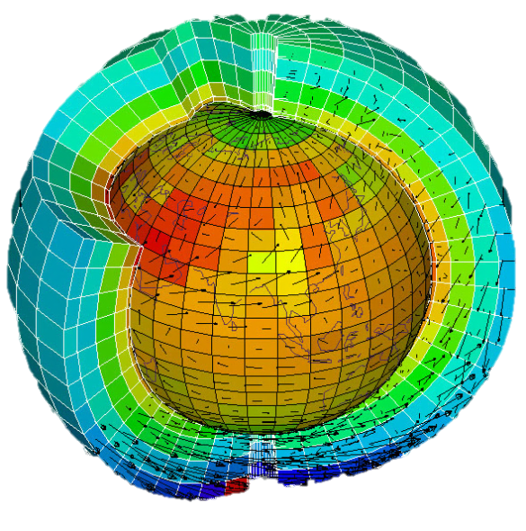
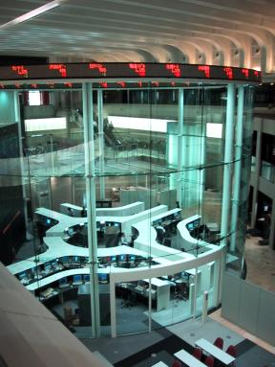
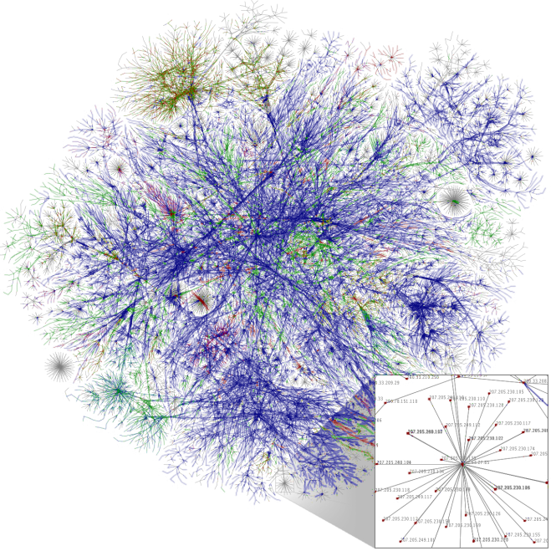
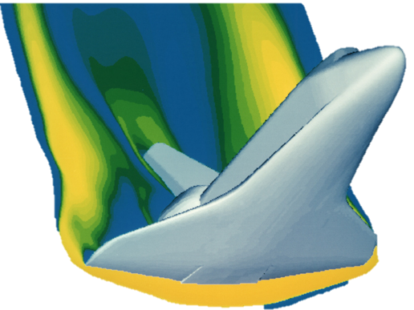
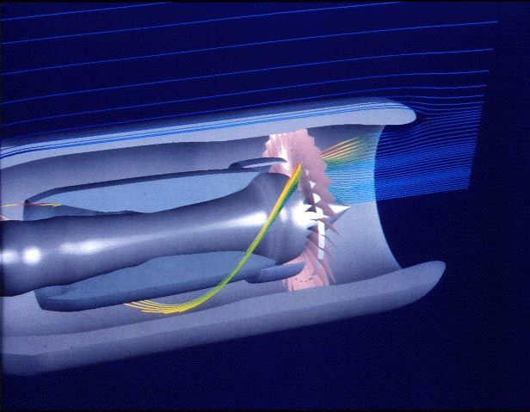
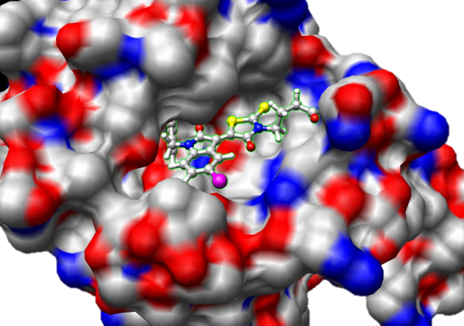
An exascale system is a high-performance system for solving big cohesive problems
Notes:
1

Slide 7
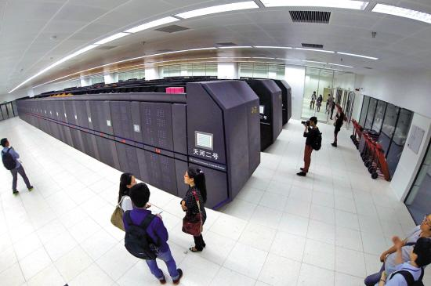
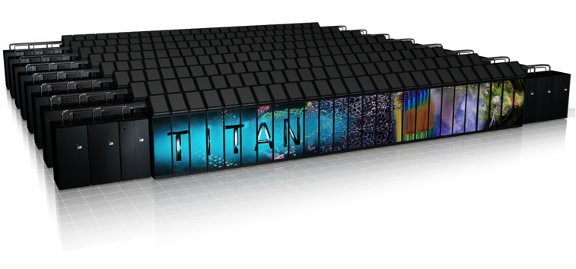
An exascale system is a high-performance system for solving big cohesive problems

Slide 8
Complexity and components

Slide 9
Performance outpaces even idealized VLSI
HW component count increases exponentially
top500.org + extrapolation
Notes:
Performance keeps marching on
Outpaces idealized technology
Technology not keeping up with ideal

Slide 10
Logic
Memory
Links
Power
Cooling

Slide 11
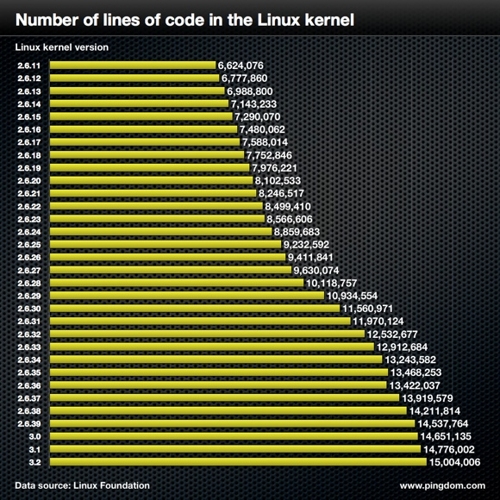
From Linux Foundation
SW growing too
HW controlled by complex and sophisticated SW

Slide 12
Management SW
Node OS
Application runtime
Application

Slide 13
What about component reliability?

Slide 14
Reliable == runs without failing
Failure means result is out of specification scope
Reliability is hierarchical – reliable systems from unreliable components
cause of failure
component departs from spec.
service departs from spec.
Fault
Error
Failure
open/short circuit
transistor wear-out
particle strike
…
Wrong value
Wrong control
Application result incorrect
Transient / non-transient fault
Error tolerance
Notes:
Here are some terminologies that I will use throughout the presentation.
A fault is an underlying cause of failure. In DRAM, it can be something like an alpha-particle strike.
Due to a fault, a component may depart from its expected behavior, which we call an error. In our research of ECC memory, error indicates incorrect read data.
A failure happens when service departs from its spec. In our research, it happens when memory returns incorrect data to processor.
In more details,
A transient fault manifests error once, while a non-transient fault manifests multiple times.
And the goal of ECC is to stop failure manifestation by detecting and correcting errors.

Slide 15
What about component reliability?
Significant uncertainty about predictions
Largely because technology doesn’t stand still

Slide 16
An alarmist extrapolation
Also with significant silent data corruption concern

Slide 17
Vendors work hard to keep reliability constant
Reliability doesn’t come cheap though

Slide 18
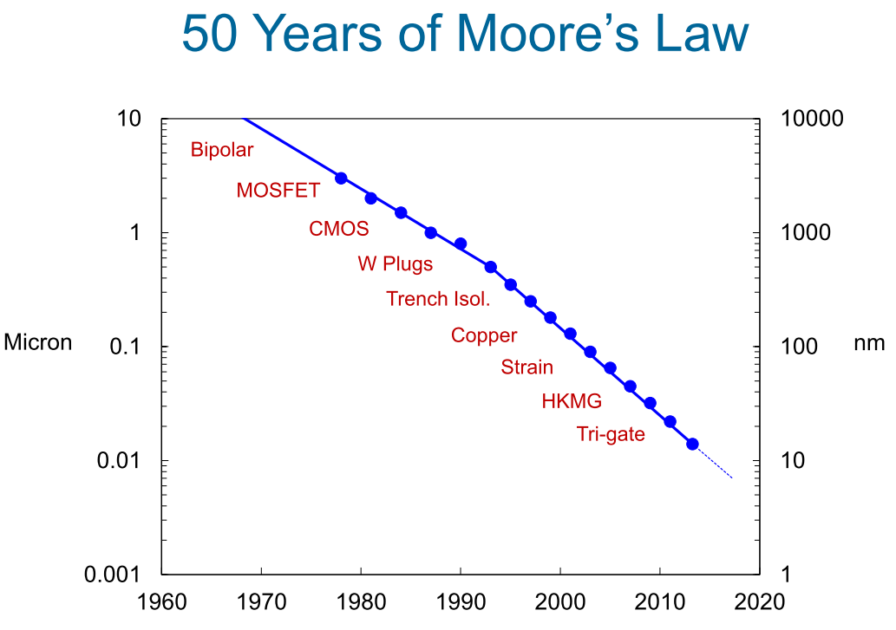
VLSI exponentials result from discrete steps
From Mark Bohr, Intel (“Moore’s Law: Yesterday, Today, and Tomorrow”, May 26, 2015

Slide 19
An optimistic projection
SDC concerns les clear

Slide 20
Can all vendors succeed?
At what cost?

Slide 21
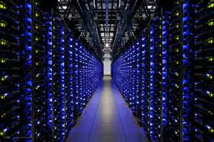
Do all customers care?
“Commercial” vs. scientific
Clouds vs. supercomputers
Games vs. supercomputers

Slide 22
The cohesiveness problem
Performance efficiency is expected performance relative to perfectly-reliable system

Slide 23
Reliability is in the eye of the beholder
Level of paranoia (life threatening?)
Monetary cost of failure (and legal implications)
Tolerance to different results
Can someone else be blamed?

Slide 24
No “right answer”
Performance/efficiency and reliability tradeoffs

Slide 25
Short course goals
For hardware, system, and application:
Understand the state of the practice
Understand the state of the art
Understand the sources of overhead
Understand how to improve resilience within a layer
Understand cross-layer resilience
Better balance of overheads and needs

Slide 26
Syllabus (basics, then bottom-up)
Overall system architecture
Fundamentals of resilience
Terminology and actions
Fault/error/failure modes and models
Past, present, and near future approaches
HW techniques + checkpoint/restart
Supercomputers aren’t clouds
But what can we learn?
Containment Domains and other future cross-layer approaches
With thoughts on approximate computing
Reporting and forecasting

Slide 27
An aside about mE

Slide 28
Big problems and emerging systems
Resilience/ Reliability
Het. Proc. / supercomputing / cloud
Memory

Slide 29
Arch-focused whole-system approach
Efficiency requirements require crossing layers
Algorithms are key
Compute less, move less, store less
Proportional systems
Minimize waste
Utilize and improve emerging technologies
Explore (and act) up and down
Programming model to circuits
Preferably implement at micro-arch/system

Slide 30
Big problems and emerging platforms
Memory systems
Capacity, bandwidth, efficiency – impossible to balance
Adaptive and dynamic management helps
New technologies to the rescue?
Opportunities for in-memory computing
GPUs, supercomputers, clouds, and more
Throughput oriented designs are a must
Centralization trend is interesting
Reliability and resilience
More, smaller devices – danger of poor reliability
Trimmed margins – less room for error
Hard constraints – efficiency is a must
Scale exacerbates reliability and resilience concerns

Slide 31
Current and graduated PhD students
Benjamin Cho
Jinsuk Chung
Seong-Lyong Gong
Cagri Eryilmaz
Dong Wan Kim
Jungrae Kim
Evgeni Krimer (NVIDIA)
Min Kyu Jeong (Oracle Labs)
Ikhwan Lee
Kyushick Lee
Mike Sullivan (NVIDIA Research)
Minsoo Rhu (NVIDIA Research)
Doe Hyun Yoon (Google)
Song Zhang
Tianhao Zheng
Haishan Zhu
Current and graduate MS students
Mehmet Basoglu (Broadcom)
Esha Choukse
Nick Kelly
Mahnaz Sadoughi (Apple)
Collaborators at
AMD
Cray
Intel
NVIDIA
Samsung
LBNL, PNNL
Stanford
Lots of great insightful feedback

Slide 32
Grew up mostly in Israel
BSc EE and BS Physics at Technion
Part-time researcher at Intel Haifa
PhD at Stanford (w/ Bill Dally)
At UT Austin since 2007
Going well (great students and collaborators)
~7 architects + ~5 systems
Very strong collaborations with others
TACC supercomputing center

