Slide 1
Toward Exascale Resilience Part 2: System Architecture and Components Resilience fundamentals
Mattan Erez
The University of Texas at Austin
July 2015

Slide 2
Algorithm
Program
Runtime
Operating system
Compiler
HW Architecture
HW Devices
Resilience
Reliability

Slide 3
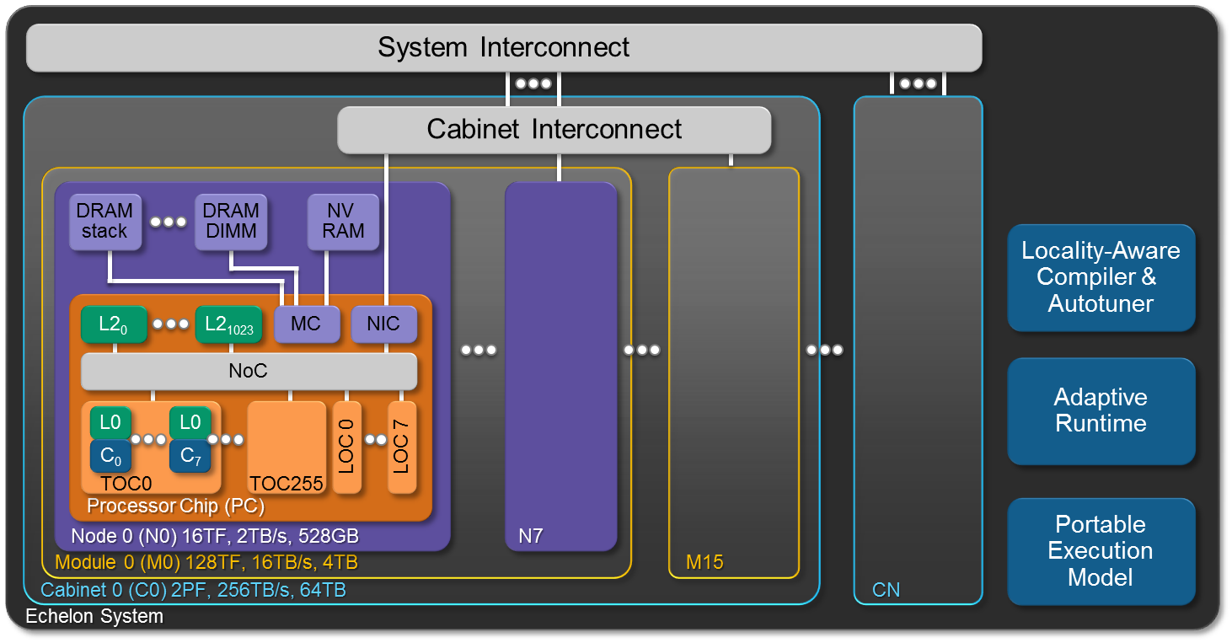
A concentrated exaflop
Cohesive system for cohesive problems

Slide 4
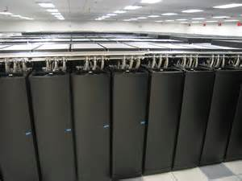
From a Cray XC30

Slide 5
Hardware summary
Cabinets (w/ VRU)
Shared power, cooling, and links (w/ VRU)
Modules (w/ VRU)
Sockets
Processors + memories
Gates, wires, and storage devices
Storage separated out (for now)

Slide 6
System software manages resources
Node operating system
Distributed file system and I/O nodes
System management and supervision

Slide 7
Resilience fundamentals
Terminology
Principles
Basic actions

Slide 8
Faults, errors, and failures
cause of failure
component departs from spec.
service departs from spec.
Fault
Error
Failure
open/short circuit
transistor wear-out
particle strike
…
Wrong value
Wrong control
Application result incorrect

Slide 9
Fault taxonomy (others exist)
What?
Component malfunction
May lead to errors
Where?
What component? Hardware or software?
How?
Natural / accidental / intentional?
When?
Permanent / transient
Active / dormant
Reproducible / random
0-day?

Slide 10
When do we care about faults?

Slide 11
Error taxonomy
What?
State that differs from fault free state
Where?
Values or control state
How?
Data dependent / independent
When?
Permanent / transient / intermittent
Reproducible / random
Impact?
Masked / detected / silent

Slide 12
Failure taxonomy
What?
Actionable outputs not within spec
Performance / power not within spec degraded operation
Where?
Can be hierarchical to a subsystem
When?
Signaled / silent
Failstop / failthrough
Consistent / inconsistent

Slide 13
Resilience = operating without failure in the presence of faults and errors
Fault tolerance
Fault mitigation
Fault avoidance
Error tolerance
Error mitigation

Slide 14
(Forecast)
Detect
Contain
Recover
Repair

Slide 15
Fault/failure forecast
Use past experience to forecast future problems
Avoid faults and failures
Reconfiguration
Preventative-repair
Traditionally done offline
Stress diagnostics
Online work looks promising
Mostly machine learning approaches
Requires effective monitoring

Slide 16
Detection
Diagnostics for faults
Redundancy for errors
Redundancy may be implicit
Detected errors may identify faults
Root-cause analysis
Requires effective reporting

Slide 17
Containment
Error propagation increases costs
More to mitigate
More likely to lead to a failure
Containment enables resilience
Careful design
Timely reporting

Slide 18
Recover (error mitigation)
Forward recovery (masking)
Requires redundancy
Some errors ignorable
Backward recovery (re-execution)
Requires preserved state

Slide 19
Repair (fault mitigation)
Reconfigure to degraded operation
Replace with hot spare
Replace with cold spare
Fix
Usually for software

Slide 20
Metrics
Why measure
Who is measuring

Slide 21
If you cannot measure it, you cannot improve it Lord Kelvin

Slide 22
FIT – the unit of resilience and reliability
Generic “faults in time”
1 FIT → 1 fault in 10⁹ hours of operation
Really annoying unit
But, rates accumulate

Slide 23
What do users care about?

Slide 24
What do users care about?
Time to completion
Cost of computation
Correctness of answer
Are they part of the solution

Slide 25
Relative efficiency
Performance, power, time, energy, … with resilience relative to assuming perfectly-reliable system
How much are overhead is a user paying for a particular resilience scheme
Setting baseline in reality is tricky
Differences between components

Slide 26
Relative correctness
Bit-by-bit perfect
Same printout
Matches expectations
Need to quantify expectations

Slide 27
Relative effort
How much is required from the user?
Users are accustomed to reliable systems
Users always resist change
How often are they interrupted

Slide 28
What about systems people?

Slide 29
What about systems people?
Underlying system failure characteristics
Availability
Overall / “Scheduled”
*MTTI (mean time to interrupt)
*MTBI (mean time between interrupts)
*MTTR (mean time to repair)
* =
System, application, job, node, …
Unscheduled donwtime

