Slide 1
Toward Exascale Resilience Part 3: Fault and error modes and models
Mattan Erez
The University of Texas at Austin
July 2015

Slide 2
Why care about models?

Slide 3
Why care about models?
Resilience isn’t free
Paying too much overhead means losing out

Slide 4
Modeling techniques
“First-principles” (simulation and analytical)
How detailed?
What parameters?
Empirical
Accelerated testing
Field studies
Extrapolations

Slide 5
Different components – different techniques
Academic are not in the best position here

Slide 6
Field studies
Collect fault, error, failure reports from actual systems
Analyze
Draw conclusions
Extrapolate

Slide 7
Field studies are hard
Limited reporting
Limited information
Limited access
Sensitive outcomes
But, that’s the actual world

Slide 8
Some excellent examples in recent years
In particular for DRAM
Starting from Sridharan and Liberty, SC’12
Good sources for other components too
Recent analysis on supercomputers and datacenters
Some other specific components too

Slide 9
Fault vs. error/failure analysis

Slide 10
Accelerated testing
Baking
Beam testing
Excellent, but
Special facilities
Special equipment

Slide 11
Back to basics

Slide 12
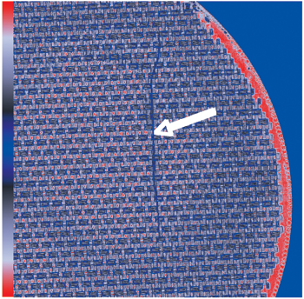
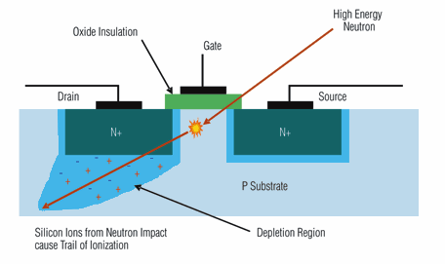
Hard faults and intermittent errors
Design flaws
Fabrication defects
Process variation
Mechanical stress
Gradual wearout
Soft faults
Alpha particles
Cosmic rays
Power supply variation
Voltage droops
Crosstalk

Slide 13
Hardware summary
Gates, wires, and memory devices
Memories and processors (sockets)
Modules (w/ VRU)
Shared power, cooling, and links (w/ VRU)
Cabinets (w/ VRU)
Storage separated out (for now)

Slide 14
Hard faults in processors
Manufacturing
Mechanical
Wearout
Industry probably has these under control
ALL customers need this to work
Several recent studies suggest it is indeed the case

Slide 15
But not clear what is sacrificed
How much better could we do if system exposed to processor hard faults?

Slide 16
Example: gradual wearout

Slide 17
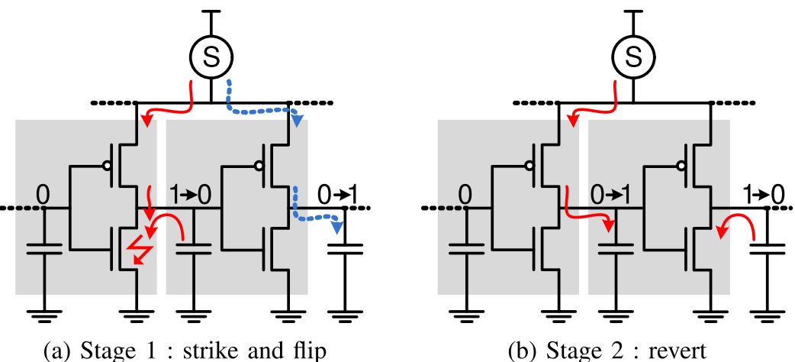
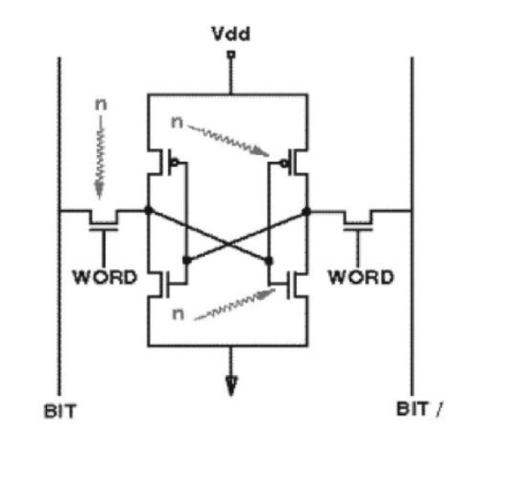
Particle-strike soft errors
Ionizing particle frees electron-hole pairs in transistor active region
Charge collected at source/drain creating current in an off device
Current can flip a bit in a storage device or change value of a logic computation

Slide 18
Why are particle strikes problematic?
Two main sources
Alpha particles
Atmospheric neutrons
Alpha particles from packaging and solder
Can be reduced but not eliminated completely
Neutrons are highly penetrating and flux can be high
Neutrons randomly strike an atom and create secondary ionizing particles
Difficult to stop, but rare
Protection overhead is high and generally “wasted”
Minimize waste by understanding vulnerability and trends
Need models for:
Particle flux, charge collection, and component vulnerability

Slide 19
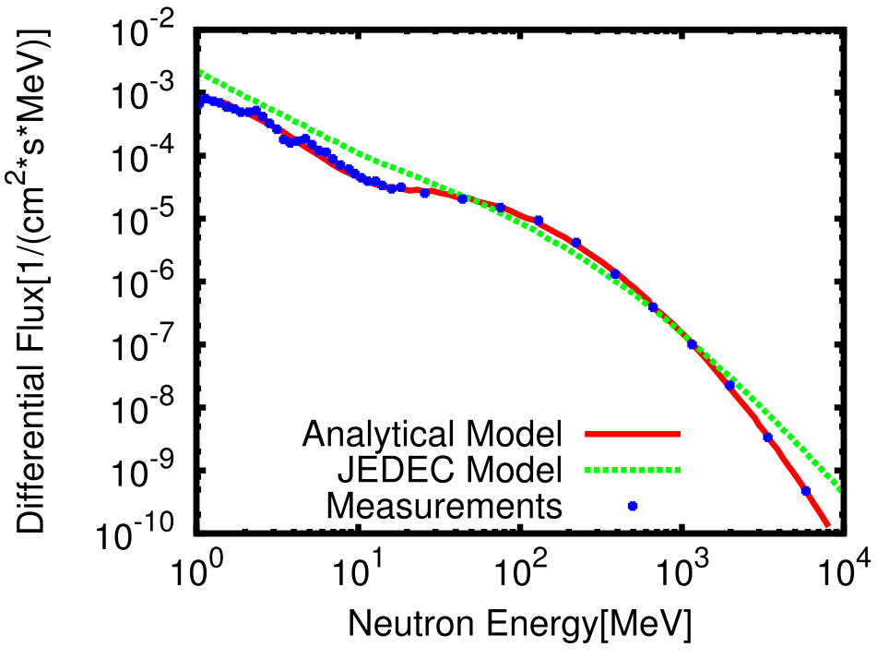
Likelihood of Strike Directly Proportional to Particle Flux
Alpha particles are low and constant flux
Neutrons more interesting and problematic
Significant number of high-energy neutrons
Even higher flux at lower energies
Lower energies may affect future technologies more

Slide 20
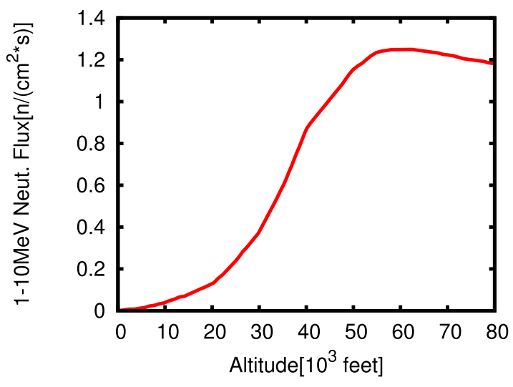
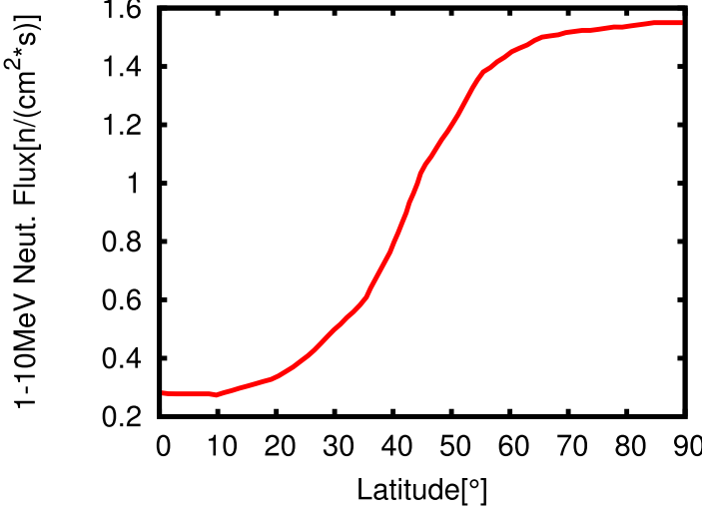
Flux Varies Significantly with Altitude and Latitude
Flux at 50,000’ is 1000 times higher than at sea level
Flux towards poles 5 times higher than equator

Slide 21
Impact of a Particle Strike
Amount of freed charge
Energy of particle (nature)
Angle of incidence (generally random)
Properties of material (hard to gauge)
Efficiency of charge collection
Volume of depletion zone (shrinks with tech. scaling)
Supply voltage (small linear impact)
Temperature (minimal impact)
Required current/charge to cause an error
Q_{crit} is minimal charge to flip an SRAM bit
Similar notion for latches
More complex for logic

Slide 22
SRAM Trends
Q_{crit} decreases with technology scaling
Lower capacitance to overcome for a flip (linear)
Lower voltage lowers Q_{crit} (linear and small)
Collected charge also decreases somewhat
Process variation increases error propensity
Variation increases as technology scales
New transistor technology reduces error propensity
Also helps limit variation
FIT per bit expected roughly constant
Denser devices increase number of bits and also likelihood of multi-bit upsets

Slide 23
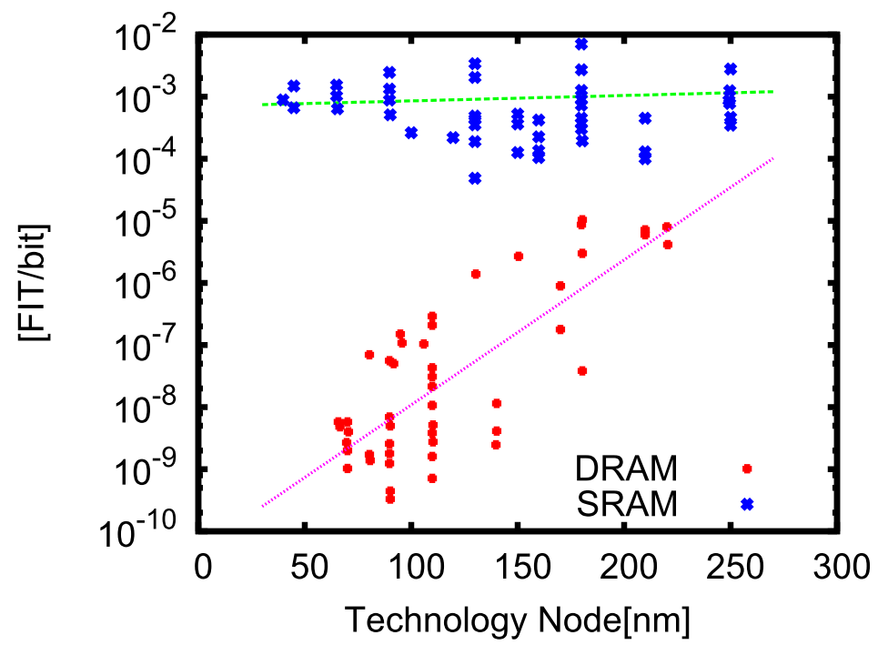
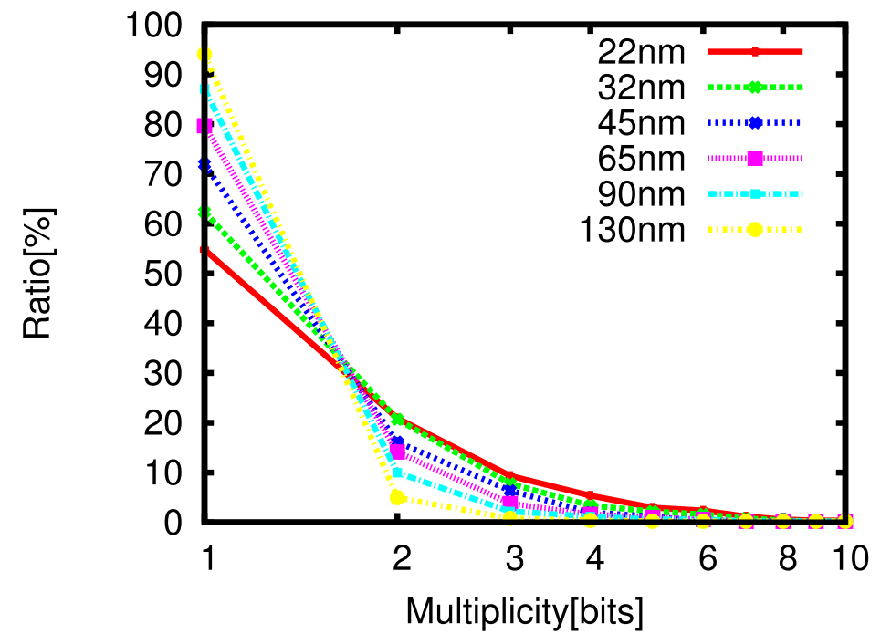
SRAM Trends
Multi-bit errors significant concern

Slide 24
Latch Trends
Similar to SRAM
Fewer bits, but large enough to be a problem
Mitigation techniques differ
Latches often synthesized rather than in arrays
Hardened latches are common, but expensive, solution
MBUs also a problem
Accesses mostly narrow

Slide 25
Logic Trends
Particle strike to off transistor “turns” it on
Charge translates to current pulse
Current flows as long as charge being collected
Current pulse may not result in an error
Logical masking (unaffected by scaling)
Temporal masking (related to frequency, expected fixed)
Electrical masking
Decreases with scale
Mitigation possible with minimal “hardening”
Overall expected 0.5% SER compared to SRAM/latch

Slide 26
Other soft faults
Shrinking margins and growing variations →
can lead to timing violations
Our research matches results from IBM research:
Gain is ~20%
Almost all this gain possible with reasonable (though dynamic) margins

Slide 27
But what about errors?
Logic faults/errors very frequently masked
Error disappears before being latched (timing)
Error diminishes and disappears because of signal rectification (electrical masking)
Values lead to logical masking

Slide 28
Error modeling?
Logic simulation
Multi-mode simulation

Slide 29
Quick(ish) way to search the error space
Multi-mode simulation
Skip over detectable errors
Tool to be released
Uses only public tools

Slide 30
DRAM faults very problematic
Dozens of DRAM chips per processor
Millions per system
New DRAM fault every couple of hours
Modules are expensive

Slide 31
Memory must be reliable
Written data must be recalled “correctly”

Slide 32
Reliability challenges
“Natural” change in cell value
Induced change in cell value
Read errors
Write errors
Wearout and defects

Slide 33
Natural causes of value change
Probability correct
Time
Decay
Refresh
Notes:
Natural change in state
Decay
DRAM leakage (refresh)
PCM, Memristor, RRAM drift
Flips
DRAM/SRAM/latch particle strikes
STT MRAM state flips
Control
Control-related soft errors corrupt values

Slide 34
Natural causes of value change
Probability correct
Probability correct
Time
Time
Decay
Refresh
Flip
ECC + scrub
Notes:
Natural change in state
Decay
DRAM leakage (refresh)
PCM, Memristor, RRAM drift
Flips
DRAM/SRAM/latch particle strikes
STT MRAM state flips
Control
Control-related soft errors corrupt values

Slide 35
Natural causes of value change
Probability correct
Probability correct
Time
Time
Decay
Refresh / scrub
Flip
ECC + scrub

Slide 36
Natural causes of value change
Probability correct
Probability correct
Time
Time
Decay
Refresh / scrub
Flip
ECC + scrub
Retention control
Less dense
Writes slower/higher-energy
Can use different devices
Notes:
Natural change in state
Decay
DRAM leakage (refresh)
PCM, Memristor, RRAM drift
Flips
DRAM/SRAM/latch particle strikes
STT MRAM state flips
Control
Control-related soft errors corrupt values

Slide 37
Induced change in value
Writing or reading disturbs nearby cells
Worse for writes
Technology and design dependent

Slide 38
Read errors
Because of small margins for efficiency

Slide 39
Write errors
Writing implies changing a state or value
Stochastic
Probability correct
Time

Slide 40
Write errors
Writing implies changing a state or value
Stochastic
Waiting inefficient and slow
Write error control conflicts w/ other errors
Probability correct
Time

Slide 41
Wearout and defects
Probability correct
Probability correct
Time
Time
Probability correct
Probability correct
Time
Time

Slide 42
Wearout and defects
Sparing
Extra margins
Retirement
Compensation (ECC)

Slide 43
Summary: no “good” memory
It’s all about tradeoffs

Slide 44
But, those tradeoffs barely up to us
Good empirical models for DRAM
So far, vendors maintaining targets
Interestingly, peripheral circuits very vulnerable

Slide 45
But at the end, good empirical models exist and are currently maintained
Rules of thumb (more later)
50/50 soft/hard
50/50 single/multi bit
Mat
Notes:
Our 3rd and final observation is from DRAM internal structure.
If we have a closer look to DRAM, each bank is partitioned into sub-structures called mats.
And for routing efficiency, data within a Mat go to the same data pin (DQ).
As a result, if a local fault generates multiple errors on a mat, it will affect only a single data pin over multiple burst beats, as shown in the figure.

Slide 46
DRAM Errors?
Highly dependent on ECC scheme
Probably pretty random

Slide 47
Other hard faults
Corrosion
Mechanical stress
Accidents
Current stress
Mechanical → power → connectors
Lots of redundancy can be put in
Recently, scaling in the chip faster than outside

Slide 48
Network
Processor + memory + links
Few models available
Generally very resilient
Strong error protection
Routing adapts to hard faults

Slide 49
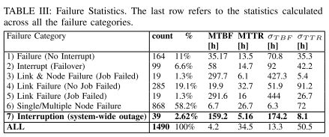
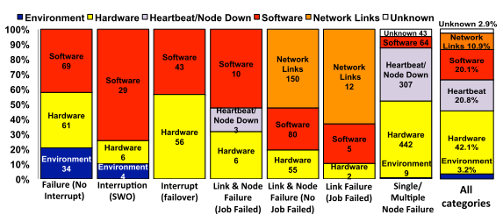
An example: Blue Waters
From Di Marino et al., DSN’14

Slide 50
An example: Blue Waters
From Di Marino et al., DSN’14

Slide 51
An example: Blue Waters
From Di Marino et al., DSN’14

