Slide 1
Toward Exascale Resilience Part 4: Memories and networks
Mattan Erez
The University of Texas at Austin
July 2015

Slide 2
Memories
Arrays of cells
Peripheral circuits
Communication
Soft and hard faults

Slide 3
Error checking and correcting (ECC)
Redundant coding for detection and correction
Most-efficient way to detect errors (and correct them)
Repair
Once fault is known, can choose to repair it
Necessary?

Slide 4
Introduction to Memory ECC
A codeword (CW)
A valid pair of {data, redundancy}
A non-codeword (NCW)
An invalid pair due to errors on CW
k-bit
data
r-bit
redundancy
k-bit
data’
r-bit
redundancy
Notes:
Here is an introduction to memory ECC.
When we try to write k-bit data to memory, ECC encoder generates r-bit redundancy from the data and writes a valid pair of data and redundancy to ECC memory, which we call a codeword.
<click>
And when we read, we expect to read the original codeword written to the memory.
However, sometimes errors make a codeword into an invalid pair of data and redundancy, which is called a non-codeword.

Slide 5
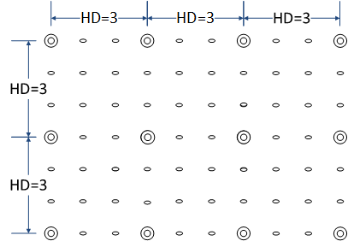
Example: Single Symbol Correcting Code
CW
NCW
Hamming Distance(HD): the number of different symbols between two words
Notes:
Here is an example of an ECC, called single symbol correcting code
We have a conceptual codespace of a single symbol correcting code.
In this code, every codeword is at least 3 symbols different from all the other codewords.

Slide 6
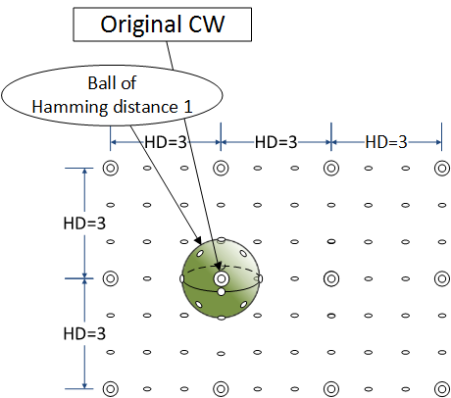
Example: Single Symbol Correcting Code
Corrected Error
Notes:
If there is a single symbol error, it will make a codeword into a non-codeword on the green ball.
The non-codeword is one symbol different from the original codeword, but at least two symbols different from all the other codewords.
<click>
And by finding the unique nearest codeword, it can be corrected to the original codeword.

Slide 7
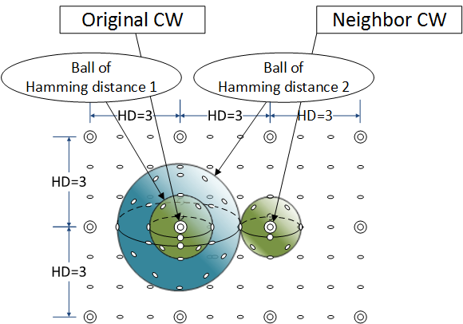
Example: Single Symbol Correcting Code
Theoretical coverage
→ NOT double symbol detecting
Detected but Uncorrectable Error
(DUE)
Mis-corrected Error
(Silent Data Corruption)
Notes:
Now, suppose we have two symbol errors.
The resulting non-codeword falls on the blue ball, and
<click>
if it’s not within a correctable range of a codeword, it will be uncorrectable error.
<click>
However, if it meets the right green ball, it will be two symbol different from the original codeword but 1 symbol different from the neighbor codeword.
Therefore, it will be mis-corrected to the neighbor codeword.
<click>
Because some double symbol errors and mis-corrected, this code is not a double symbol detecting code.
This is what coding theory tells us and people tend to stop here and pessimistically consider errors beyond this theoretical coverage, I mean two errors, are somewhat likely to result silent data corruptions.

Slide 8
#1 – Codeword Size
We can have 99.9999% detection
Longer codewords exponentially reduce SDC
Notes:
Our first key observation is from codeword size.
We wondered what happens beyond this theoretical bound and started testing serious error patterns.
And it turned out that even though we cannot have a 100% detection of these errors, we can make it very close to 100%.
<click>
Our first key observation is that SDC occurs if and only if a non-codeword falls on another green ball. And its probability decreases exponentially with sparse code space.

Slide 9
How Much Redundancy Do We Need?
Depends on
Protection Strength
Data size
Symbol size
Symbols
…
k-bit
data
r-bit
redundancy
A codeword
Notes:
Now, I’d like to talk about the efficiency of ECC.
The amount of ECC redundancy depends on three factors; its correction and detection capability, data size and finally its symbol size.
A symbol is the unit of data and redundancy in ECC.
<click>
By correcting a symbol, all errors within the symbol, no matter how many of them, are corrected.

Slide 10
#2 – Symbol Size
8-bit symbol achieves the minimum
Redundancy ratio = {redundancy sym} / {corrected sym}
Sym size | Codeword (512-bit data) | Redun. size (bit) | Redun. ratio
1-bit
Data: 1b x 512 sym
Redun: 10 sym
10-bit
10
…
4-bit
Data: 4b x 128 sym
Redun: 3 sym
12-bit
3
…
8-bit
Data: 8b x 64 sym
Redun: 2 sym
16-bit
2
…
16-bit
Data: 16b x 32 sym
Redun: 2 sym
32-bit
2
…
Notes:
And the efficiency of ECC code can be improved by finding the optimal symbol size.
This figures shows how much redundancy do we need to correct a single symbol error on 512-bit data.
This figure shows how many redundancy we need to correct a single symbol on 64-byte data block.
With binary symbols, we can correct this small binary symbol using 10 redundant symbols.
With 4-bit symbols, we need 3 nibbles to correct a nibble, which corresponds to 12-bit redundancy for 4-bit correction.
With 8-bit symbols, we need 2 symbols to correct a single symbol, which corresponds to 16-bit redundancy for 8-bit correction.
While, smaller symbols requires less-number of redundant bits, their correction is constrained to their small symbols
And to correct the same amount of bits, 8-bit symbol has the minimum redundancy ratio of 2 from the Singleton bound.
Once, we achieve the minimum redundancy using 8-bit, bigger symbols
Once we achieve the minimum redundancy of 2, the finer will provide a stronger protection in dealing with distributed errors.

Slide 11
#3 - DRAM Internal Structure
Most errors affect a single data pin only
Per-mat data go to the same data pin
Mat
Notes:
Our 3rd observation is from DRAM internal structure.
If we have a closer look to DRAM, each bank is partitioned into sub-structures called mats.
And, for routing efficiency, data within a Mat go to the same data pin.
<click>
Therefore, if a local fault generates multiple errors on a mat, <click> it will affect only a single data pin over multiple burst beats, as shown in the figure.

Slide 12
Memory Transfer Block
Notes:
Now, with these 3 of our key observations, let’s go back to memory.
This is a block of data transferred per an memory access.
As shown in the previous slide, a block of data is transferred from memory per an access.

Slide 13
Historical ECC
SEC-DED (Single Error Correcting – Double Error Detecting)
Per-beat codeword with binary symbols
12.5% redundancy on 64-bit data
Notes:
Previous ECCs b
Before we present our work, here are some prior works.
The most widely known ECC memory is SEC-DED.
It can correct single bit-error and detect up to two bit errors.
<click>
Here is the layout of SEC-DED.
It’s codeword correspond to a bus beat
It
It relies on binary symbols on a per-bus-beat codeword and has one eighth redundancy.
SEC-DED is a weak protection, cause it cannot correct multi-bit errors from a chip fault.
This block of data reresents a cache line fetched from a memory read.

Slide 14
Current ECC
Chipkill-correct
AMD Chipkill-correct
Double-bus-beat codeword with 8-bit symbol
12.5% redundancy on 64-bit data
Notes:
Another prior work is AMD chipkill-correct.
It is called chipkill-correct as it can restore data from a completely failed chip.
It merges two burst beats of a x4 chip to build an 8-bit symbol.
If a chip fails, it can restore all data within the bursts with a single symbol correction.
In spite of its strong correction, its redundancy is the same as SEC-DED, due to its 8-bit symbol size.
The industry standard for a higher-level protection is called chipkill-correct, where the ECC can tolerate a single failing DRAM chip.
While there are several chipkill –correct implementation used, the most aggressive and the state-of-the-art scheme offer 12.5% redundancy over 64b channel.
And an example of such a state-of-the-art chipkill correct is AMD chipkill-correct.
There are some other chipkill correct ECCs. However they rely on wider data interfaces to amortize their bigger redundancy overheads.
In this work, AMD chipkill will be used as our baseline, because it’s the state-of-the-art ECC with the minimum redundancy.

Slide 15
Post-processing of Corrections
Discard corrections if suspicious
AMD Chipkill
A.k.a History-based miscorrection detection
Notes:
All of sudden, there are three pin errors on a codeword. Because faults are mostly independent, it is highly unlikely that this correction results is from three independent faults. And probably from a mis-correction of a very serious fault.
Therefore, we discard the corrections and report the error as DUE to lower SDC rate.

Slide 16
Bamboo ECC
Based on a very simple idea
Change ECC layout
Vertical symbol
8-bit symbol
Aligned to frequent per-pin errors
On a large codeword
Memory transfer block
Notes:
Now I have to tell you the secret.
Bamboo ECC is based on a very very simple idea.
It changes ECC layout, to have vertical symbols, rather than the horizontal symbols in the previous works.
Its 8-bit symbol from the burst length achieves the minimum redundancy of 2 per corrections.
And if frequent per-mat fault corrupts per-pin data, it needs only a single symbol to correct the multi-bit errors.

Slide 17
Low-end Bamboo ECC
Single Pin Correcting (SPC/1PC)
Corrects 1 pin error using 2 pin redundancy
3.1% redundancy on 64-bit data
Notes:
Now, we present our Bamboo ECC.
The idea of Bamboo ECC is really simple, probably the simplest in this conference.
We change the layout of ECC code from horizontal to vertical so that 8-bit symbol are aligned to per-pin data.
Alter, if there is a per-pin fault <click>, it can correct it, using a single symbol correction with two pin redundancy.
Single pin correcting code is the simplest Bamboo ECC, and its 2 pin redundancy is only a quarter of SEC-DED.
Also, to our surprise, its reliability is better than SEC-DED.

Slide 18
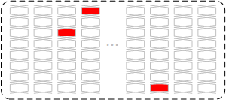
Low-end Bamboo ECC
SPC vs. SEC-DED
 | Which one is better? | Note
Correction probability (A) | SEC-DED
Raw error rate (B) | SPC | ~91% (16.5 chips vs. 18 chips)
Overall: uncorrected errors (B x (1-A)) | SPC | ~95%
SPC vs. SEC-DED
¼ redundancy
Lower uncorrected error rate
SEC-DED
SPC
Notes:
Let me explain more about this.
In terms of correction capability, SEC-DED is better than SPC as it can correct more error patterns, such as this.
However, because SPC requires less redundancy and fewer memory chips, its raw error rate is only 91% of SEC-DED.
Therefore, if this error pattern is rare, SPC will have fewer uncorrected errors.
Our evaluation based on field data shows that SPC has 5% fewer uncorrected errors.
<click>
Therefore, SPC requires only a quarter redundancy of SEC-DED but provides better reliability.

Slide 19
Bamboo ECC: A Family of Codes
Fine-grained control over redundancy
Costs are proportional to protection
 | SPC |  | SPC- TPD |  | QPC |  | OPC
Redundancy (pin) | 2 | … | 4 | … | 8 | … | 16
Correction (pin) | 1 | … | 1 (or 2) | … | 4 | … | 8
Notes:
Bamboo ECC is a family of codes.
It can increase redundancy with fine-grained pin-granularity, resulting diverse configurations with different protections.
At a low-end, there is SPC, which can correct a single pin error using two pin redundancy. And at a high-end, OPC can correct a x8 chip error using 16 pin redundancy.
And there are many other Bamboo ECCs in between.

Slide 20
Low-end Bamboo ECC (Cont’)
Single Pin Correcting – Triple Pin Detecting (SPC-TPD)
Vs. SEC-DED
½ redundancy (4 pins)
Fewer uncorrected errors
Safer detection (up to 51% vs. 0.0004% SDC)
Notes:
The second Bamboo ECC is SPC-TPD
While SPC achieves the minimum redundancy of two pins, off-the-shelf DRAM has the minimum data pin count of 4.
SPC-TPD uses this 4-pin redundancy to correct a single pin error and detect up to 3 pin errors.
SPC-TPD requires only a half redundancy of SEC-DED but provides a better reliability in terms of less uncorrected errors and by far safer detection.
Errors on more-than-3-pins are detected with 99.9996% probability, which is up to 100,000 times safer than SEC-DED.

Slide 21
Middle-/High-end Bamboo ECC
Quadruple Pin Correcting (QPC/4PC)
Corrects one x4 chip error, using 8 pin redundancy
Octuple Pin Correcting (OPC/8PC)
Corrects one x8 chip error, using 16 pin redundancy
Compared to AMD Chipkill
Same redundancy (8 pins / 12.5%)
Stronger correction (e.g. two chips)
Safer detection
Notes:
A chipkill correct Bamboo ECC is QPC.
Using 8-pin redundancy, QPC can correct a x4 chip by correcting its 4 pins.
Both AMD chipkill and QPC have the same minimum redundancy of 12.5%.
However, QPC can correct 12% more, such as pin errors on two different chips and its detection is by far safer.
---- Make slides bigger and separate.
<click>
For x8 DRAM chips, we provide a even stronger Bamboo ECC. Its name is OPC and it can correct one x8 chip error or two x4 chips errors, using 16 pin redundancy.

Slide 22
#4: SDC Reduction
Discard corrections if suspicious
E.g. 4PC
SDC probability (for a severe error)
QPC: 2⁻¹² 2⁻²⁷
OPC: 2⁻²² 2⁻⁵⁴
Post processing
4 pin corrections on 4 different chips
Discard
4 pin corrections on a chip (a chip error)
Take
2 pin corrections on 2 different chips
Take
Cf.) AMD Chipkill’s history-based miscorrection detection
Notes:
To improve the detection capability even further, QPC and OPC have post-processing of corrections.
Some corrections are very unlikely to be real.
For example, in QPC, we can have four pin corrections on four different chips.
While they are valid corrections, our experience tells that four independent pin fault on four different chips at the same time is extremely unlikely with reasonable retirement and scrubbing.
Therefore, we assume these corrections are from a miscorrection of a very serious error. So we discard them.
We limit QPC’s correction capability to a chip correction or 2 pin corrections, which is still better than AMD chipkill. And other corrections are reported as DUE.
<click>
AMD chipkill has a similar scheme, called history-based miscorrection detection.
<click>
After this tuning, SDC probabilities of QPC and OPC decrease down to 2^-27 and 2^-54.
With these numbers, yes, we can have a silent data corruption, but after you retire your job.
And this exteremly low probabilities apply to other serious errors as well, such as when the entire rank failed and all the data are corrupted.

Slide 23
#5: Graceful Downgrade
Issue: non-transient faults
71% of faults / 99.9% of errors
More severe errors / repeated corrections
Retirement
Can be costly
Graceful downgrade using pin retirement
Tolerate up to 14 pin faults (or 3 chips + 2 pins)
without rebuilding data
8PC
(16pin)
7PC-
8PD
(15pin)
7PC
(14pin)
…
1PC
(2pin)
Notes:
Reduntant bit-steering.
Not only individual Bamboo ECC is better than its counterparts, Bamboo ECC, as a family of codes, provides even better protection.
Non-transient faults in memory takes 71% of the faults and generates 99.9% of the errors.
And they make errors more severe with fault accumulations.
They cost repeated correction overheads and forces early retirement.
<click>
Retiring the faulty region is the common solution. However, some retirements are costly as they require the entire DIMM or chip to be replaced, especially in 3D stacked memories.
<click>
Bamboo ECC provides graceful downgrades among its solutions.
It supports pin retirement, where a faulty chip or pin is excluded and the remaining memory provide a slightly degraded protection.
It can be degraded down to SPC-TPD, which still provides 99.9996% detection, or SPC, which still can correct a pin error.
<click>
The maximum number of pin retirement is 14 in OPC. And this level of retirement is something not provided by existing ECCs.
This is well-aligned to the faults patterns where single pin fault is about a half of the total faults.
Another awesome thing about Bamboo ECC is that we don’t need to rebuild data after a downgrade, as they rely on the same Reed-Solomon code.

Slide 24
Backed up by backward recovery

Slide 25
Evaluation: Reliability
FaultSim¹
ErrorSim
Decoder
MonteCarlo
Sim
MonteCarlo
Sim
Bamboo ECC
or
other ECC
Fault rate info²
Fault history
Error pattern
Result
[1] “FAULTSIM: A fast, configurable memory-resilience simulator”, D. Roberts, et al. The Memory Forum ’14
[2] “A study of DRAM failures in the field”, V. Sridharan and D. Liberty, SC’12
Notes:
To evaluate reliability of Bamboo ECC, we devised a new evaluation methodology, which is based on 3 stages.
On the first stage, we implemented FaultSim from the memory forum 14’ to generate random faults from measured faults rates and Poisson distribution.
<click>
Its output is fault history.
<click>
On the second stage, another Monte-Carlo simulation, called ErrorSim, receives the accumulated fault information and generates random error pattern based on it.
<click>
Once an error pattern is generated, the final stage tests the pattern against different ECCs and find out whether it is detected or corrected.

Slide 26
System-level Reliability (72b channel)
Compared AMD Chipkill
(Lower is better)
10,000 x lower SDC
4PC → 1PC-3PD
4PC → 1PC-3PD → 1PC
A system with 100K ranks (18 x4 chips/rank)
Notes:
Here is the evaluation result.
On a system with 100,000 ECC ranks, which is about the size of Jaguar.
QPC has ten thousand times lower SDCs than AMD Chipkill.
QPC also has slightly better DUE rate than AMD Chipkill. However, both are almost certain to have a DUE within a year, because non-transient faults accumulates and generate multi-chip errors.

Slide 27
System-level Reliability (72b channel)
Compared AMD Chipkill
1,000 x lower DUE
(Lower is better)
4PC → 1PC-3PD
4PC → 1PC-3PD → 1PC
A system with 100K ranks (18 x4 chips/rank)
Notes:
With graceful degradations of Bamboo ECC, which AMD chipkill does not afford, it can delay the fault accumulation with retirements and decrease the DUE rate by a thousand times.

Slide 28
System-level Reliability (144b channel)
Compared doubled AMD Chipkill¹
OPC: No SDC (with 2 x 10¹¹ runs)
A system with 100K ranks (36 x4 chips/rank)
[1] Same layout as AMD Chipkill but doubled the codeword and correction capability.
Notes:
Here is another evaluation on wider memory channels with stronger ECCs.
In summary, we were not able to observe a single occurrence of SDC with 200B simulations of OPC.
And, again, OPC is slightly better DUEs.
OPC provides 2% lower DUE

Slide 29
System-level Reliability (144b channel)
Compared doubled AMD Chipkill¹
10,000 x lower DUE
A system with 100K ranks (36 x4 chips/rank)
[1] Same layout as AMD Chipkill but doubled the codeword and correction capability.
Notes:
Also, graceful downgrades of OPC provide 10,000 x lower DUE.

Slide 30
Overheads
Logic
 | AMD Chipkill | QPC | Note
Area (NAND2 gates) | 1,600 | 25,000 | 16 x
Latency (XOR2 gates) | 8 | 10 | + 2
Logic overheads of encoder and decoder (error detection part), each
Performance
2% (H. mean) execution time increases¹
Due to +3 read/write latency to wait symbol transfer
Energy
<1% (H.mean) DRAM energy increases¹
[1] SPECcpu2006 on Gem5 simulator (2GHz 1-core / 2M LLC / 2GB (64+8)b DDR3-1600)
Notes:
The overheads of Bamboo ECC are acceptable
As Bamboo ECC rely on larger codewords, its encoder and decoder are more complex than their counterparts.
For example, QPC has 16 times larger area and 2 gates more latency than AMD chipkill.
However, considering billions gates in current chips, this area overhead is very acceptable to deal with increasing memory errors.
Also, a delay of 10 XOR gates can be easily implemented within a single memory cycle.
<click>
Another overhead of Bamboo ECC is additional latency.
As symbols are NOT fully available until the completion of a block transfer, it has 3 additional cycles.
This results average of 2% increase in execution time and less than 1% increase in DRAM energy consumption.

Slide 31
What about repair?
Is there any benefit given strength of ECC?

Slide 32
What about repair?
Repair reduces risk of failure and SDC
Repair can improve performance/efficiency
Reduce correction overhead
Fault rates may be rising
Same question about vendor success as processors

Slide 33
How to repair memory?
Replace module
Replace bits
Disable bits / modules

Slide 34
How to replace bits?
Remap (reconfigure)
Redirect (cache)

Slide 35
Row and column sparing
Used in all memories for yield
Used in some DRAMs for repair (LPDD4)
Simple changes to existing decoders / muxes
Remap at quite coarse granularity

Slide 36
Bit / cache-line remapping
Remap bits to pool of spares
Error correcting pointers
FREEp (cache lines)
ArchShield

Slide 37
Redirect – fault caching
Small cache that intercedes for remapped bits (blocks)
Can be integrated with DRAM or with processor

Slide 38
Remap/redirect schemes depend on fault model
How many bits do faults affect?
Are those bits localized or scattered?
Examples on board (slides maybe after class)

Slide 39
Combining ECC with repair very effective
Delay module replacement by years
Reduce potential SDC rate by orders of magnitude

Slide 40
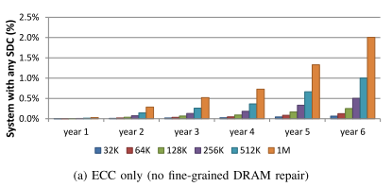
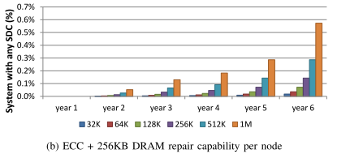
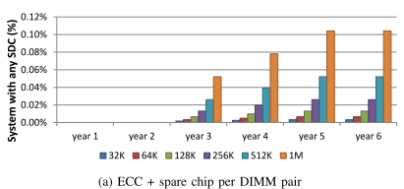
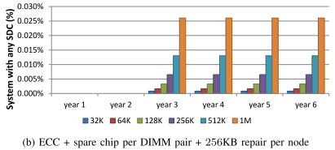
1 - 2% of systems will have SDCs with just ECC
.3 - .6% of systems will have SDCs with just ECC + repair
.1% of systems will have SDCs with ECC + ECC downgrade
.02% of systems will have SDCs with just ECC + ECC downgrade + repair

Slide 41
Networks added later.

