Slide 1
Toward Exascale Resilience Part 6: System protection with checkpoint/restart
Mattan Erez
The University of Texas at Austin
July 2015

Slide 2
Hardware reliability never perfect
Not worth the cost
Though can get close with high cost
Software also has errors
Can never fully debug

Slide 3
Application and system must go on

Slide 4
Detect→contain→repair→recover

Slide 5
Detection is most critical piece
We’re in luck – silent-data-corruption very rare
Strong ECC
Not very vulnerable logic
The paranoid among us aren’t convinced though
More when we talk about cross-layer approaches

Slide 6
What to do on detected errors?
Simplest idea: failstop!
Contain the error and don’t let it propagate

Slide 7
If system stopped, can the application continue?
Yes, if prepared
Checkpoint/restart

Slide 8
Periodically, take checkpoint
Stop the system
Copy all state somewhere sage
Keep going
Rollback
Recover saved state
Restart
Recompute and keep going

Slide 9
Things to think about (outline)
How frequently to checkpoint?
How important is checkpoint time?
And what can we do to improve it
Who decides to take a checkpoint?
System or user
Do we really have to stop everyone to take a checkpoint?
Coordinated vs. uncoordinated checkpointing
Always (for now) coordinated restart
Great survey paper:
_{ElNozahy et} _{al.,} “A Survey of Rollback-Recovery Protocols in Message-Passing _{Systems”} (http://www.cs.utexas.edu/~lorenzo/papers/SurveyFinal.pdf)

Slide 10
How often should we take a checkpoint?
Want to maximize efficiency
Too frequent – time wasted on checkpointing
Too infrequent – time wasted on re-execution
Can we optimally balance the two?
Sure, let’s see how

Slide 11
What determines CP/RS effectiveness?
How long between failures (failstops)
How long to repair and recover
How long to take checkpoint

Slide 12
Time between failures (AMTTI)
Not up to CP/RS scheme – system parameter
Currently ~5 hours and trending down

Slide 13
Time to repair
If spare nodes: repair takes seconds (at most)
If no spare nodes: repair hidden by other jobs
Deallocate and reallocate failed job
From system perspective, repair time very short

Slide 14
Time to recover
Read state back in
Usually similar to taking checkpoint
Re-execute all lost work

Slide 15
Time to take the checkpoint
Stop the system
Depends on technique used, but can be fast
Copy state somewhere safe
~25MB/s per node typical global file system BW
Worse when many nodes write together
~100GB per node
Continue execution
Kind of long, let’s see what that means

Slide 16
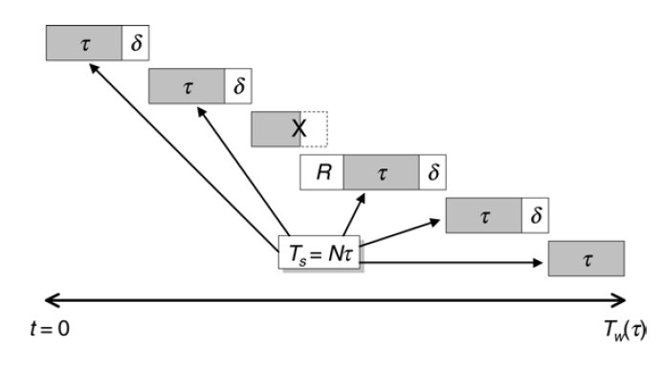
Estimating execution time with CP/RS
Excellent paper by J. Daly, Future Generation Computer Systems 22 (2006)
Took figures and equations from that paper
Total = solve + checkpoint + reexec + repair

Slide 17
First order model
No interrupts during checkpoint or recovery
Interrupts occur in the middle of an interval (expected)
Poisson process for interrupts
# checkpoints
Total
Ideal
repair
recover time
# interrupts

Slide 18
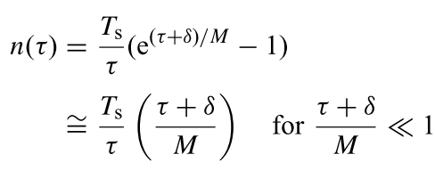
When Poisson and when checkpoint interval << MTTI
then:

Slide 19
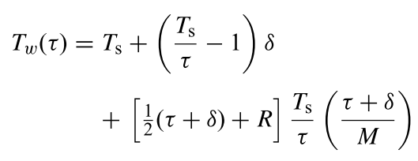
First-order equation:
Minimize time (control interval)

Slide 20
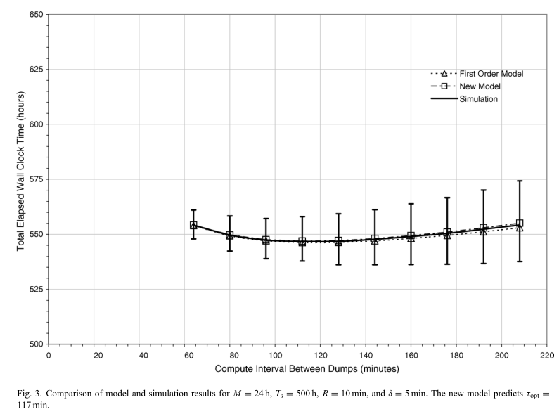
How good is the first order model?
Great yesterday, w/ 5min checkpoints and 25h MTTI

Slide 21
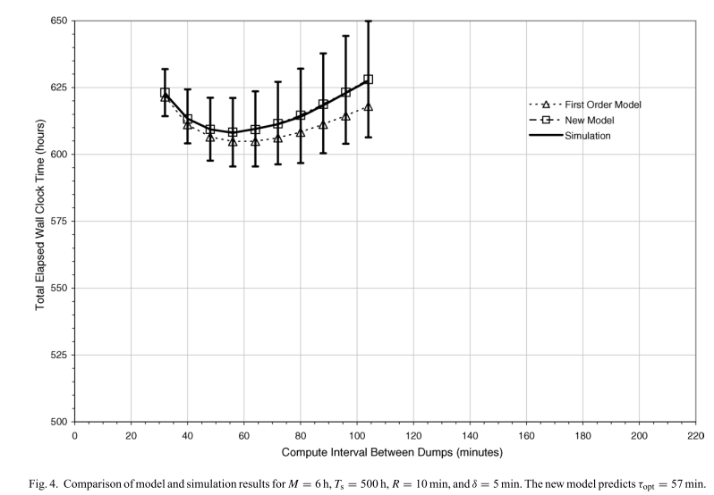
How good is the first order model?
OK today, w/ 5min checkpoints and 5h MTTI

Slide 22
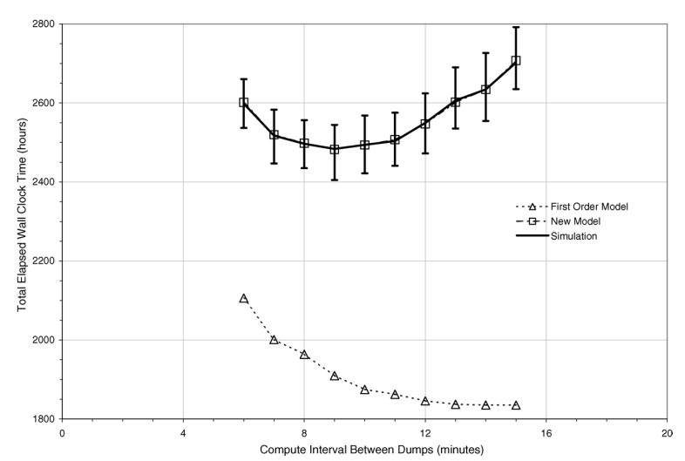
How good is the first order model?
Bad in the future (MTTI = 15min, checkpoint = 5min)
Ignored interrupts during checkpoint and restart
Ignored greater likelihood of failing early in a period

Slide 23
So what is the rough efficiency?
Good today, but tomorrow

Slide 24
What can we do?
Improve reliability
Expensive
Reduce checkpoint overhead?

Slide 25
How can we reduce the checkpoint overhead?
Copy less state
Overlap copy and compute
Copy faster

Slide 26
Copy less state?
Only preserve critical live state
Ask programmer
Analyze
Incremental checkpointing
Only save the delta from prior checkpoint
Need to track what changed (can use OS protection mechanisms)
Garbage collection a big issue – when do we no longer need old state?
Recovery much more complicated

Slide 27
Overlap copy and compute?
Take quick checkpoint locally (e.g., to SSD)
BW can be 2GB/s per node – 100x improvement
Slowly copy out to global file system during computation
What happens on interrupt?
May have to rollback to previous full checkpoint
“Burst buffers”
Can also use memprotect to copy the checkpoint in the background
Similar to VM live migration

Slide 28
Copy faster
Build more BW to global file system
Partition and replicate file system
Use hierarchy?

Slide 29
“Scalable checkpoint restart”
Take frequent checkpoints to memory
Less frequent to SSD
Less frequent to global file system
Can adjust number of levels
_{Moody} _{et} _{al.,} _{SC10}

Slide 30
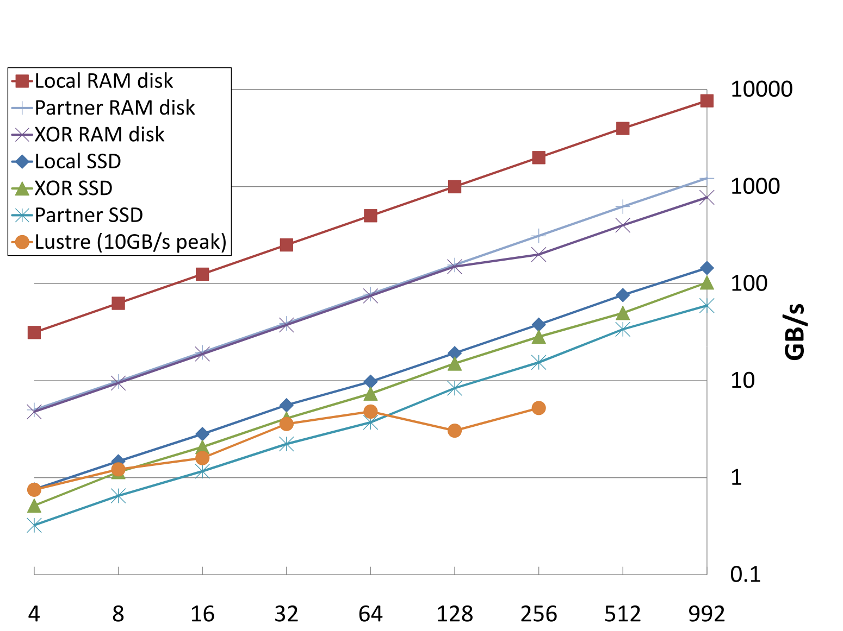
Saving locally not very effective for node failure
Copy to a “buddy” instead
Coding can reduce memory requirements

Slide 31
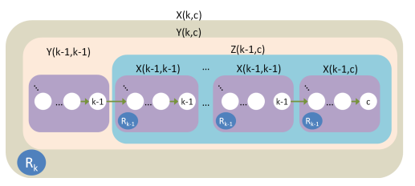
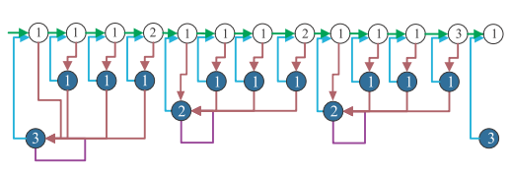

Slide 33
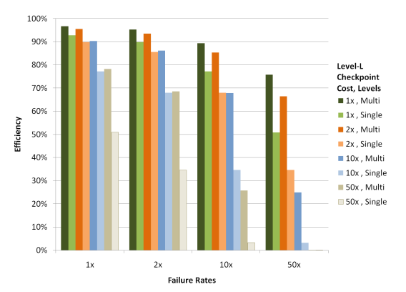

Slide 34
Things to think about (outline)
How frequently to checkpoint?
How important is checkpoint time?
And what can we do to improve it
Who decides to take a checkpoint?
System or user
Do we really have to stop everyone to take a checkpoint?
Coordinated vs. uncoordinated checkpointing
Always (for now) coordinated restart
Great survey paper:
_{ElNozahy et} _{al.,} “A Survey of Rollback-Recovery Protocols in Message-Passing _{Systems”} (http://www.cs.utexas.edu/~lorenzo/papers/SurveyFinal.pdf)

Slide 35
Who decides when to checkpoint User or system?
Requirement: consistent checkpoint
Implication: no inflight messages
(for coordinated)
What gets checkpointed?

Slide 36
Identifying consistent points
User knows
Annotate
Runtime may know
Certain runtime calls imply consistency
MPI collectives and barriers
System doesn’t
Must quiesce network to take checkpoint
Often impractical, but SDN might help?

Slide 37
What data should be checkpointed?
Programmer can identify minimal set
But what if programmer missed something?
Compiler analysis may help
System can use OS page table and protection mechanisms to checkpoint

Slide 38
Both are in use today
Application-level libraries (more common)
User can ask if checkpointed needed and then decide to call checkpoint routine
User can ask for checkpoint periodically and library can skip
System-level
Integrated with kernel
Dumps entire application state (or incremental one)

Slide 39
Things to think about (outline)
How frequently to checkpoint?
How important is checkpoint time?
And what can we do to improve it
Who decides to take a checkpoint?
System or user
Do we really have to stop everyone to take a checkpoint?
Coordinated vs. uncoordinated checkpointing
Always (for now) coordinated restart
Great survey paper:
_{ElNozahy et} _{al.,} “A Survey of Rollback-Recovery Protocols in Message-Passing _{Systems”} (http://www.cs.utexas.edu/~lorenzo/papers/SurveyFinal.pdf)

Slide 40
Coordinated checkpointing is straightforward
Find consistent time
Checkpoint
Uncoordinated is not
How to deal with in-flight messages?
How to deal with in-flight remote loads/stores?

Slide 41
Side note: message passing vs. global address space
Two sided or one sided communication
Send/recv or put/get

Slide 42
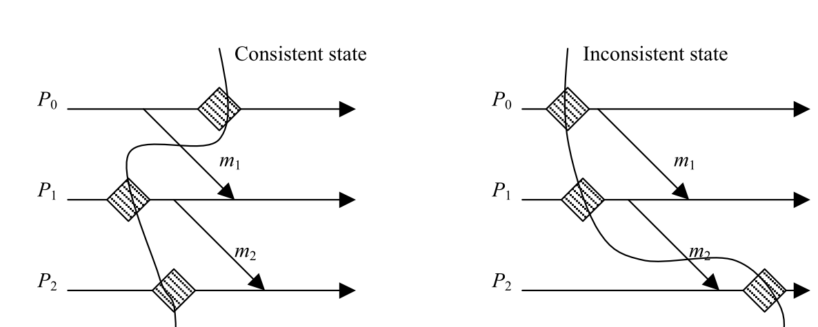
Uncoordianted checkpointing w/ messages
Distributed systems theory (and practice)
Checkpoint each process mostly independently
Goal is to enable rollback to a consistent state
Everyone re-executes and agrees on all results
From ElNozahy et al., ACM Comp Surveys, 06/2002

Slide 43
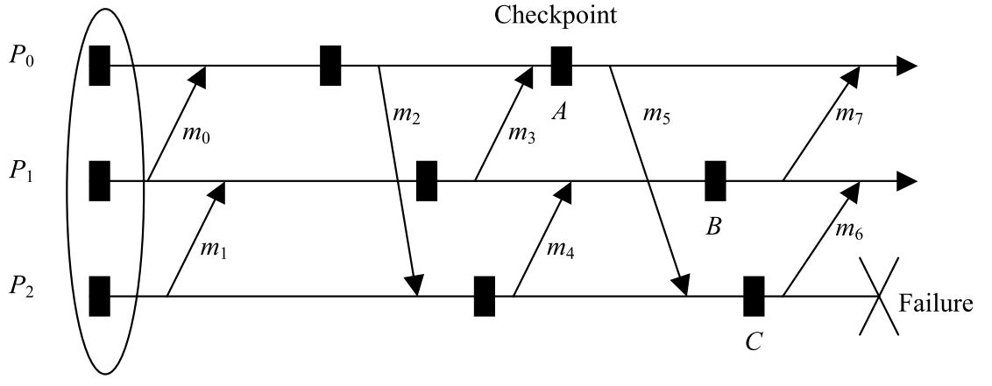
The Domino Effect _{(Randell, 1975)}
From ElNozahy et al., ACM Comp Surveys, 06/2002

Slide 44
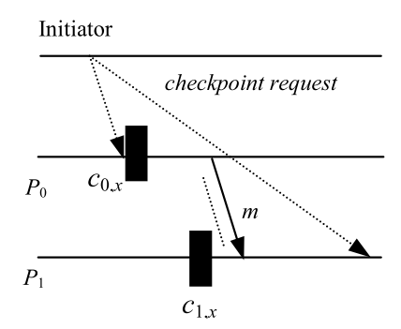
Coordinated non-blocking
From ElNozahy et al., ACM Comp Surveys, 06/2002

Slide 45
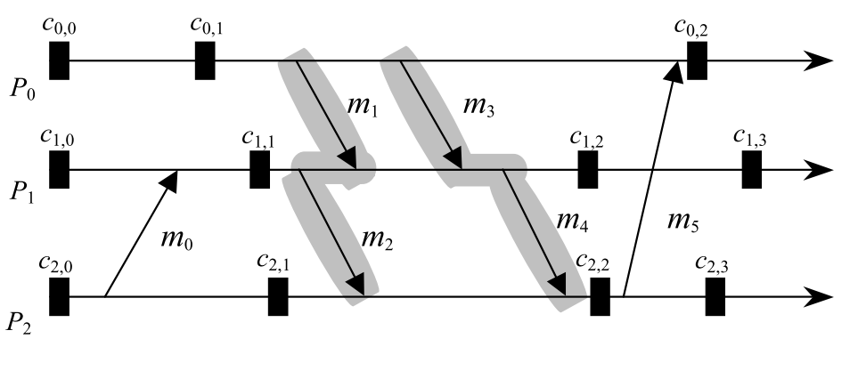
Communication-induced
Useless
From ElNozahy et al., ACM Comp Surveys, 06/2002

Slide 46
Uncoordinated
Message logging
Pessimistic vs. optimistic
From ElNozahy et al., ACM Comp Surveys, 06/2002

Slide 47
Example protocol

Slide 48
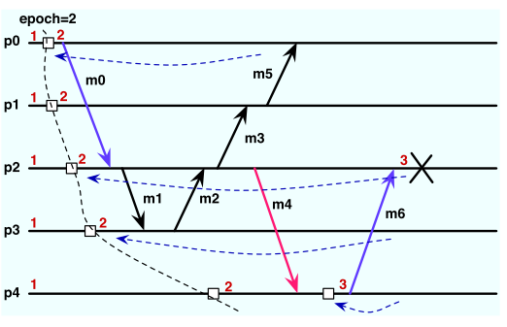
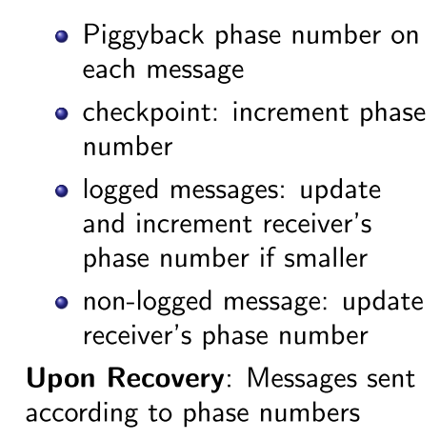
From A. Guermouche et al., IPDPS 2012

Slide 49
Sender or receiver logs?
Receiver is easier, but complicated if optimistic and interrupted
Sender is easier when logging, but recovery can be complicated
As is possibly garbage collection

Slide 50
Non-blocking with message logging
Coordinate a consistent point to checkpoint, but don’t block
Start logging messages to eliminate domino effect
Stop logging when checkpoint consistent and done

Slide 51
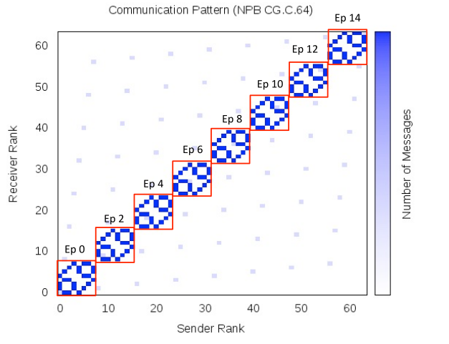
Hierarchical coordinated/uncoordinated groups
Log messages hierarchically between groups of grouped processes
More on this when discussing containment domains
From A. Guermouche et al., IPDPS 2012

Slide 52
Uncoordinated recovery?
Possible, but challenging
From ElNozahy et al., ACM Comp Surveys, 06/2002

Slide 53
Global address space way more complicated
One sided communication happens without remote aware of communication
Fine-grained sync and comm
Very relaxed memory consistency models
Consistent points hard to find
Quiescing the network too expensive
Active area of research (with few/no proofs yet)

Slide 54
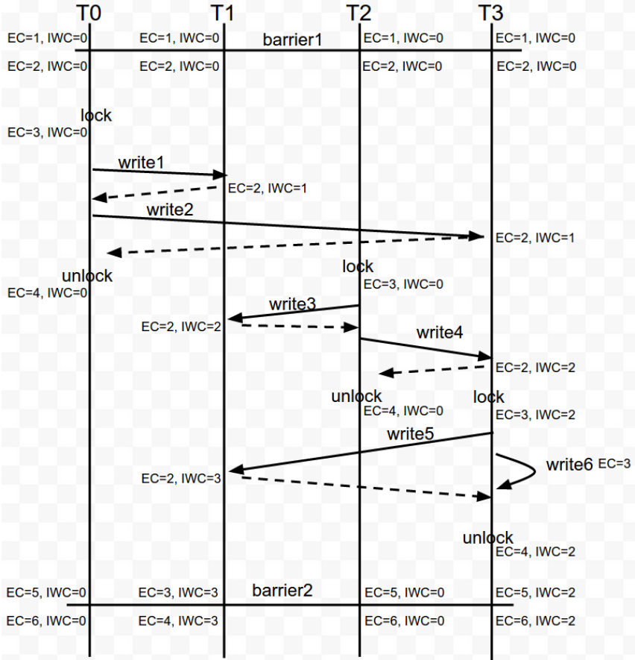

Slide 55
Detect→contain→repair→recover

Slide 56
Periodically, take checkpoint
Stop the system
Copy all state somewhere sage
Keep going
Rollback
Recover saved state
Restart
Recompute and keep going

Slide 57
Things to think about (outline)
How frequently to checkpoint?
How important is checkpoint time?
And what can we do to improve it
Who decides to take a checkpoint?
System or user
Do we really have to stop everyone to take a checkpoint?
Coordinated vs. uncoordinated checkpointing
Always (for now) coordinated restart
Great survey paper:
_{ElNozahy et} _{al.,} “A Survey of Rollback-Recovery Protocols in Message-Passing _{Systems”} (http://www.cs.utexas.edu/~lorenzo/papers/SurveyFinal.pdf)

Slide 58
Redundant MPI
An alternative to checkpoint/restart

