Slide 1
Toward Exascale Resilience Part 7: What about clouds?
Mattan Erez
The University of Texas at Austin
July 2015

Slide 2
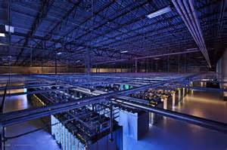
Very large systems
Very distributed computing
Not typically single cohesive problems

Slide 3
Main cloud concerns
Availability
Management
Sharing

Slide 4
Main cloud applications
Storage
Search
Localized analytics
Many independent requests
Throughput matters, but latency caps
Limited communication
Very relaxed consistency
Main exascale applications
Cohesive computations
Full-scale analytics
Checkpointing
Few (one) large application
Throughput paramount
Heavy communication
BW and latency important

Slide 5
Resilience implications
Interrupts much less critical in the cloud
Better hardware not good enough for customer storage anyway
Most computation is approximate already

Slide 6
Today, similarities abound
Xeons, mostly
ECC memory
Dense packaging

Slide 7
But very important differences
Virtualization vs. bare metal
Lots of performance lost
Aavailability and management gains
Not really different hardware, but shows focus not perf.
Ethernet vs. specialized interconnects
Differences in workloads
Limited throughput-computing in the cloud
Only in special-purpose components (groups of racks)
Because latency actually important
Exascale will need everywhere

Slide 8
Possible cloud/exascale divergence
That will not be good
Likely scenario: exascale will have to make use of cloud-oriented processors
Many differences are really software stack

Slide 9
What can we learn from the cloud?
Make jobs look more independent
Manage jobs and sharing
Be ready to approximate

Slide 10
Making jobs look independent
Switch algorithm
E.g., Monte Carlo
Switch programming model
Tasks based data flow
Transactional approaches
Utilize hierarchy
Containment domains

Slide 11
Manage jobs and sharing
Preemptive migration
Failure forecasting
Incremental and non-blocking (overlapped) CP
Alternatives to global coordinated recovery

Slide 12
A word on system noise

Slide 13
Prepare to approximate

Slide 14
20MW / 1 exa-FLOP/s Energy ≤ 20pJ/op
50 GFLOPs/W sustained
Best supercomputer today: ~300pJ/op

Slide 15
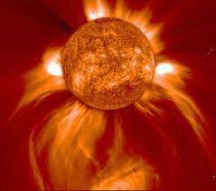
Actual processing
I/O
Arithmetic
Comm.
…1001010010100…
×
+
√
x²
−
Control
Memory
Idle/margin
How much of each component?
Notes:
9
How much of each component?
How much energy per use?
What balance between them?
What budget?

Slide 16
+
×
Arithmetic
64-bit floating-point operation
_{Rough estimated} _{numbers}
√
x²
−
50
260
40
Arith.
Headroom
30
20
40
5
10
20
15
0
Today
Scaled
Researchy
Notes:
10

Slide 17
Enough headroom?

Slide 18
Unfortunately, hard tradeoffs
20mm
64-bit DP
15pJ
DRAM
Rd/Wr
15 pJ
80 pJ
2 nJ
256-bit
buses
Efficient
off-chip
link
500 pJ
15 pJ
256-bit access
8 kB SRAM
100 pJ
10nm
Notes:
11+12

Slide 19
+
×
Need more headroom
Minimize waste
√
x²
−
Notes:
How much of each component?
How much energy per use?
What balance between them?
What budget?

Slide 20
+
×
Do we care about single-unit performance?
Must all results be equally precise?
Must all results be correct?
Lunacy?
√
x²
−
Notes:
13

Slide 21
+
×
Relaxed reliability and precision
Some lunacy (rare easy-to-detect errors + parallelism)
Lunatic fringe: bounded imprecision
Lunacy: live with real unpredictable errors
√
x²
−
50
40
Arith.
Headroom
30
20
40
5
8
12
10
20
18
15
12
8
0
2
Today
Scaled
Researchy
Some
Lunatic
Lunacy
_{Rough estimated} _{numbers for illustration} _{purposes}
lunacy
fringe
Notes:
14

Slide 22
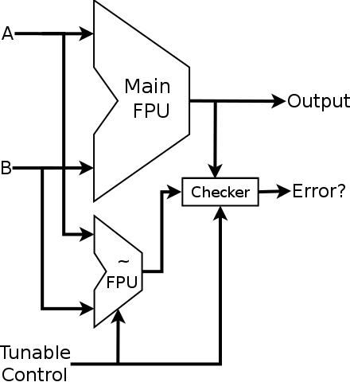
+
×
Bounded Approximate Duplication
√
x²
−

Slide 23
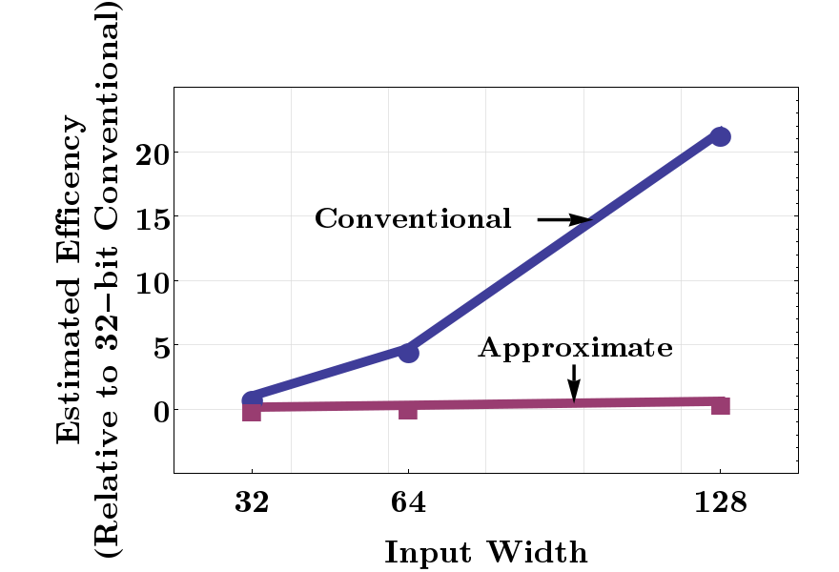
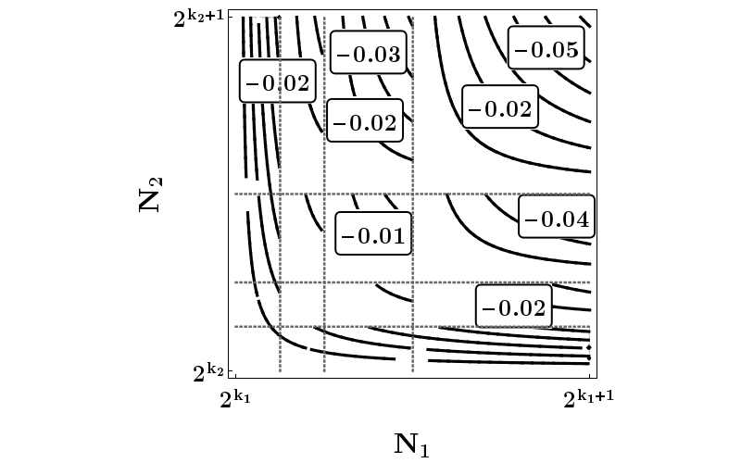
+
×
Bounded Approximate Duplication
√
x²
−
Notes:
15

