Slide 1
Toward Exascale Resilience Part 8: Containment Domains / cross-layer schemes
Mattan Erez
The University of Texas at Austin
July 2015

Slide 2
Credit to:
UT Austin students:
Benjaming Cho, Jinsuk Chung, Ali Fakhrzadehgan, Ikhwan Lee, Kyushick Lee, Seong-Lyong Gong, Mike Sullivan, Song Zhang, Doe Hyun Yoon (now at Google)
Collaborators (growing list)
Cray, NVIDIA, ETI
LBNL: Brian Austin, Dan Bonachea, Paul Hargrove , Sherry Li, Eric Roman
Funding agencies
DOE ECRP, XStack, FF, PSAAP II
Initial funding from DARPA UHPC

Slide 3
The constraints:
Power/energy
Time
Money
Correctness

Slide 4
Resilience is a big challenge for DOE computations

Slide 5
Something bad every ~minute at DOE scale

Slide 6
The baseline: checkpoint-restart
Not good enough on its own

Slide 7
Failure rate too high for checkpoint/restart
Correctness also at risk

Slide 8
Energy also problematic

Slide 9
The cost of resilience
Preparation
Detection
Mitigation (repair + recover)
Implementation

Slide 10
Software?
Hardware?
Algorithm?

Slide 11
Software?
Hardware?
Algorithm?
Containment Domains: adaptive holistic approach
Per-experiment balance of energy, time, money, correctness

Slide 12
Can hardware alone solve the problem?
Yes, but costly
Significant and likely fixed overheads
May not be needed in many commercial settings

Slide 13
Fixed overhead examples (estimated) Both energy and/or throughput
Up to ~25% chipkill correct vs. chipkill detect
20 – 40% for pipeline SDC reduction
>2X for arbitrary correction
Even greater overhead if protecting approximate units

Slide 14
Something bad every ~minute at DOE
Something bad every year commercially
Smaller units of execution
Different requirements

Slide 15
Locality and hierarchy are key
Hierarchical constructs
Distributed operation
Range of correctness requirements

Slide 16
What about algorithmic resilience?
Algorithmic detection
Iterative converging algorithms
Redundant information
Probabilistic methods

Slide 17
Examples on board
Algorithmic check of matrix multiplication
Algorithmic check of a solver
Convergent calculation
Simple and basic Newton-Raphson
Monte Carlo

Slide 18
But,
Different apps → different techniques Different scales → different techniques

Slide 19
Need to adapt/co-tune

Slide 20
Containment Domains elevate resilience to first-class abstraction
Program-structure abstractions
Composable resilient program components
Regimented development flow
Supporting tools and mechanisms

Slide 21
Containment Domains
Abstract resilience constructs that span system layers
Hierarchical and Distributed operation for locality
Scalable to large systems with high energy efficiency
Heterogeneous to match disparate error/failure effects
Proportional and effectively balanced
Tunable resilience specialized to application/system
Analyzable and auto-tuned

Slide 22
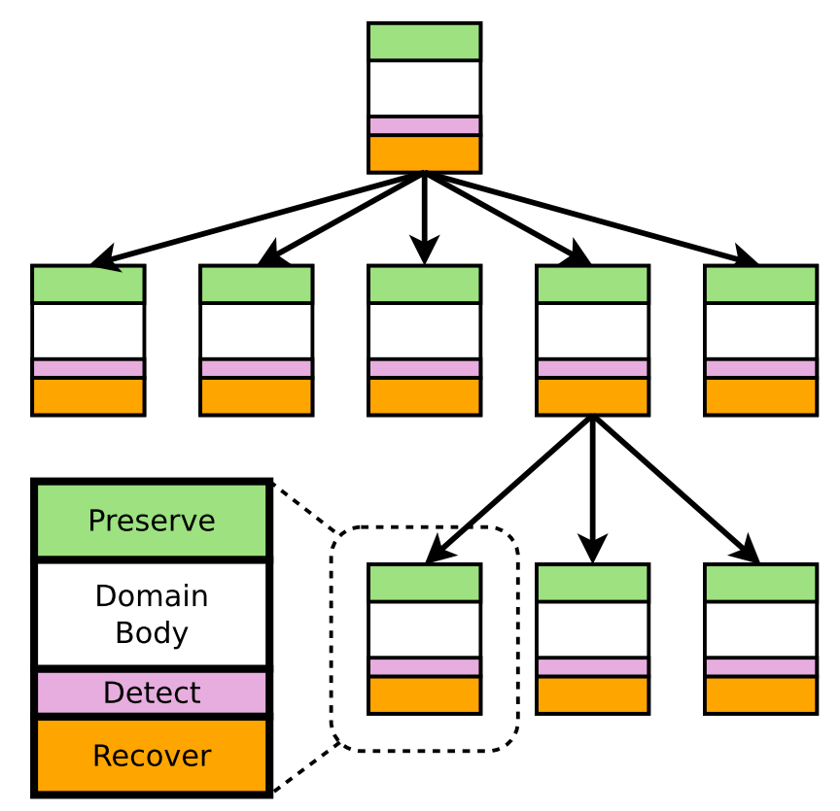
CDs Embed Resilience within Application
Express resilience as a tree of CDs
Match CD, task, and machine hierarchies
Escalation for differentiated error handling
Semantics
Erroneous data never communicated
Each CD provides recovery mechanism
Components of a CD
Preserve data on domain start
Compute (domain body)
Detect faults before domain commits
Recover from detected errors
Root CD
Child CD

Slide 23
Mapping example: SpMV
void task<inner> SpMV(in M, in Vi, out Ri) {
cd = GetCurrentCD() ->CreateAndBegin();
cd->Preserve(matrix, size, kCopy);
forall(…) reduce(…) SpMV(M[…],Vi[…],Ri[…]);
cd->Complete();
}
$$M$$
$$V$$
void task<leaf> SpMV(…) {
cd = GetCurrentCD() ->CreateAndBegin();
cd->Preserve(M, sizeof(M), kRef); cd->Preserve(Vi, sizeof(Vi), kCopy); for r=0..N
for c=rowS[r]..rowS[r+1] resi[r]+=data[c]*Vi[cIdx[c]];
cd->CDAssert(idx > prevIdx, kSoft);
prevC=c;
cd->Complete();
}
Matrix M
Vector V

Slide 24
Mapping example: SpMV
void task<inner> SpMV(in M, in Vi, out Ri) {
cd = GetCurrentCD() ->CreateAndBegin();
cd->Preserve(matrix, size, kCopy);
forall(…) reduce(…) SpMV(M[…],Vi[…],Ri[…]);
cd->Complete();
}
$$M_{00}$$
$$M_{01}$$
$$V_{0}$$
$$M_{10}$$
$$M_{11}$$
$$V_{1}$$
void task<leaf> SpMV(…) {
cd = GetCurrentCD() ->CreateAndBegin();
cd->Preserve(M, sizeof(M), kRef); cd->Preserve(Vi, sizeof(Vi), kCopy); for r=0..N
for c=rowS[r]..rowS[r+1] resi[r]+=data[c]*Vi[cIdx[c]];
cd->CDAssert(idx > prevIdx, kSoft);
prevC=c;
cd->Complete();
}
Matrix M
Vector V

Slide 25
Mapping example: SpMV
void task<leaf> SpMV(…) {
cd = GetCurrentCD() ->CreateAndBegin();
cd->Preserve(M, sizeof(M), kRef); cd->Preserve(Vi, sizeof(Vi), kCopy); for r=0..N
for c=rowS[r]..rowS[r+1] resi[r]+=data[c]*Vi[cIdx[c]];
cd->CDAssert(idx > prevIdx, kSoft);
prevC=c;
cd->Complete();
}
$$M_{00}$$
$$M_{01}$$
$$V_{0}$$
$$M_{10}$$
$$M_{11}$$
$$V_{1}$$
Matrix M
Vector V
Distributed to 4 nodes
$$M_{00}$$
$$V_{0}$$
$$M_{10}$$
$$V_{0}$$
$$M_{01}$$
$$V_{1}$$
$$M_{11}$$
$$V_{1}$$

Slide 26
Mapping example: SpMV
void task<leaf> SpMV(…) {
cd = GetCurrentCD() ->CreateAndBegin();
cd->Preserve(M, sizeof(M), kRef); cd->Preserve(Vi, sizeof(Vi), kCopy); for r=0..N
for c=rowS[r]..rowS[r+1] resi[r]+=data[c]*Vi[cIdx[c]];
cd->CDAssert(idx > prevIdx, kSoft);
prevC=c;
cd->Complete();
}
$$M_{00}$$
$$M_{01}$$
$$V_{0}$$
$$M_{10}$$
$$M_{11}$$
$$V_{1}$$
Matrix M
Vector V
Distributed to 4 nodes

Slide 27
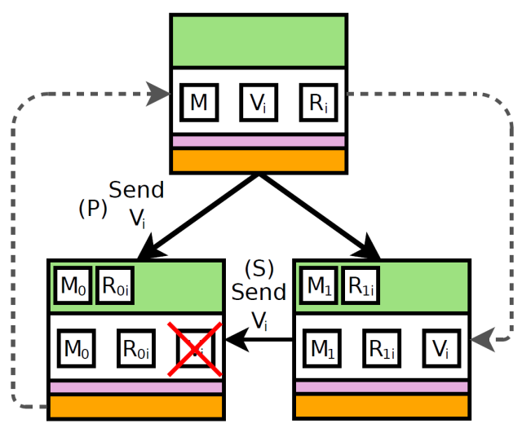
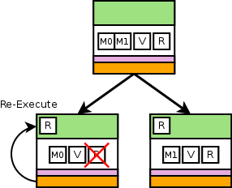
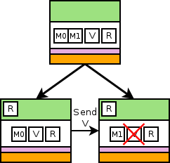
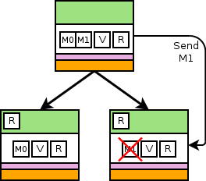
Concise abstraction for complex behavior
void task<leaf> SpMV(…) {
cd = GetCurrentCD() ->CreateAndBegin();
cd->Preserve(M, sizeof(M), kRef); cd->Preserve(Vi, sizeof(Vi), kCopy); for r=0..N
for c=rowS[r]..rowS[r+1] resi[r]+=data[c]*Vi[cIdx[c]];
cd->CDAssert(idx > prevIdx, kSoft);
prevC=c;
cd->Complete();
}
Local copy or regen
Sibling
Parent (unchanged)

Slide 28
Programming and execution model support

Slide 29
CDs manage preservation, restoration, and re-execution
Allocate and frees storage
Transfer data
Manage default error detection
Call appropriate CD (hierarchy level) on error/fault
Holistic error reporting
Specific policies can be written by the user
Specialize and tune every aspect of resilience
Straightforward abstractions
CD abstraction amenable to analysis and auto-tuning
Analytical model fed with application properties
Notes:
##Single Consistent abstraction##
1. One of the key aspects of containment domains are that they are single consistent abstraction.
2. Abstractions enable us to capture existing resilience techniques.
3. You can have a consistent way of expressing resilience concerns from application through analysis down to system implementation.
##Components##
4. To achieve that we express a program with a hierarchy of containment domains. Each containment domains has four components.
##Semantics##
5. In addition to four components, we require each containment domain to obey two simple semantics.
6. Errorneous data is never communicated out side of a containment domain.
7. Each containment domain provides some mechanism for recovery. It could be reexecution, re-generation of the data, or potentially because we have hierarchy of containment domains, some errors may not be efficiently tolerated in a certain containment domain level and instead the error can be escalated. If everything escalates all the way to the root it essentially matches global check point restart.
-------------------------------
Containment domain is a single consistent abstraction that encapsulates resilience concerns.
In addition to four components, we require each containment domain to obey two simple semantics.
No erroneous data is consumed by other domains.
Second, is that each cd provides
Recovery could be escalation.
If the overhead of handling the error at this level is too high, it gets escalated.
During the mapping, which error is handled at a level is decided.
Hierarchy and containment is key enabling mechanisms for handling errors efficiently. Also for simplifying the analysis.
--------------------------------------------------
Main points: Containment Domains encapsulates existing techniques + Erroneous data never communicated + Hierarchy
-> This makes analysis easy
-> Also makes error handled hierarchical -> thus efficient
If the overhead of handling the error at this level is too high, it gets escalated.
During the mapping -> which error is handled is decided -> if overhead is too high make them escalate.

Slide 30
CD Runtime System Architecture
Annotations, persistence, reporting, recovery, tools
External Tool
Internal Tool
CD-annotated Applications/Libraries
Future Plan
Compiler Support
Debugger
User Interaction for customized error
detection /handling / tolerance / injection
CD-App
Mapper
CD Runtime System
Scaling Tool
(LWM2)
Persistence Layer
State Preservation
Communication Logging
Runtime Logging
Unified Runtime Error Detector
Error
Handling
Auto-tuner
Interface
CD
Auto Tuner
CD-Storage
Mapping Interface
Communication Runtime Library
(Legion + GasNet)
Legion + Libc
Low-Level Machine Check HW/SW I/F
Profiling & Visualization Interface
BLCR
Sight
Hardware
DRAM
SSD
HDD
Buddy
PFS
Error Reporting Architecture

Slide 31
CD usage flow
Annotate
Profile and extrapolate CD tree
Supply machine characteristics
Analyze and auto-tune
Flexible preservation, detection, and recovery
Refine tradeoffs and repeat
Execute and monitor
CD management and coordination
Distributed and hierarchical preservation
Distributed and hierarchical recovery

Slide 32
CD annotations express intent
CD hierarchy for scoping and consistency
Preservation directives and hints exploit locality
Correctness abstractions
Detectors and tolerances
Recovery customization
Debug/test interface
Work in progress: http://lph.ece.utexas.edu/users/CDAPI

Slide 33
State preservation and restoration API
curCD->Preserve(ptr,size,method_mask, byref_name, name, regenObj);
Hierarchical
Per CD (level)
Match storage hierarchy
Maximize locality and minimize overhead
Proportional
Preserve only when worth it (skip preserve calls)
Exploit inherent redundancy
Utilize regeneration
Notes:
Different error mechanisms can be dealt with different storage.
Containment domains give you explicit control on this.
Distributed, hierarchical and partial state preservation saves bandwidth and power.
Partial preservation is very easy to express with containment domains.
Containment domains are analyzable and can be automatically tuned.
Explain preserve only when worth it
You don’t want to preserve everything for every error mechanism.
--------------------------------------------
Mainpoint: Distributed, hierarchical and partial state preservation saves bandwidth and power.
Mainpoint:
Mattan: partial preservation reduces overheads substantially and is very easy to express (preserve_via_parent and/or escalate). Also add that this can be analyzed and auto-tuned.
Mix with SPMV example.
Stress that this is the main advantage of CDs in terms of performance.
Give an example of SpMV (natural redundancy)
-----------------------------------
This preservation need not be complete

Slide 34
Hierarchical local recovery and partial preservation
Disk
Inter-cabinet NVM
Inter-node NVM
DRAM
Partial preservation via sibling, parent, or regeneration where appropriate
Notes:
But CDs are better match for codes like neutron transport where structure of the code looks like a tree of tasks. And there are fewer global synchronization points.
-----------------------------------------
Leaves don’t preserve these.
Naturally recover from above.
Again, it’s not that you can not do this today
Accessable and auto-tuned interface.
Machine specific can be tuned with CDs.
Mainpoint: Point is that these span a range of behavior. Not comprehensive, but still a range
After strengths slids, give example how the mini apps were analyzable. (pick one application)
A Monte Carlo approach to the simulation of neutron transport is desirable because the creation and simulation of every particle is independent, making the problem embarrassingly parallel.
HPCCG is a linear system solver that uses the
conjugate gradient method and can scale to a large number
of nodes
How we came up with the machines. (how we scaled)
Theoretical machines.
Mention containment domain we selected was based on auto tuning.
From these workloads we extracted containment domain structures and tuned it with our tools. (preservation intervals… and stuffs)
Synthetic application of
Each CDs annotated with
Mention it matches with SCR paper.
Mention everything is tuned with our tools (optimum interval)
Mantevo
NT is more like a tree of tasks
Leaves don’t preserve these.
Naturally recover from above.
Again, it’s not that you can not do this today
Accessable and auto-tuned interface.
Machine specific can be tuned with CDs.
Mainpoint: Point is that these span a range of behavior. Not comprehensive, but still a range
After strengths slids, give example how the mini apps were analyzable. (pick one application)
A Monte Carlo approach to the simulation of neutron transport is desirable because the creation and simulation of every particle is independent, making the problem embarrassingly parallel.
HPCCG is a linear system solver that uses the
conjugate gradient method and can scale to a large number
of nodes
How we came up with the machines. (how we scaled)
Theoretical machines.
Mention containment domain we selected was based on auto tuning.
From these workloads we extracted containment domain structures and tuned it with our tools. (preservation intervals… and stuffs)
Synthetic application of
Each CDs annotated with
Mention it matches with SCR paper.
Mention everything is tuned with our tools (optimum interval)
Mantevo

Slide 35
Local copy or regen
Parent (unchanged)
Sibling

Slide 36
Correctness abstractions
Detectors
Requirements
Recovery

Slide 37
What can go wrong?
Application crash
Process crash
Process unresponsive
Failed communication
Hardware
Cache error
Memory error
TLB error
Node offline
…

Slide 38
What can go wrong?
Lost resource
Wrong value
Specific address?
Specific access?
Specific computation?
Degraded resource
Who detects?
How reported?

Slide 39
Today: machine check architecture
(Maskable) interrupts
Complex encoding of errors / failures
Spread across many processor-specific state registers
Very difficult to parse and use
Currently – level of containment reported
Enables fine-grained software recovery
Know before state is corrupted
Know when only process state is corrupted
Event counters and triggers for errors
Root cause analysis

Slide 40
Today: machine check architecture
Not suitable for programmers
Barely suitable for system implementers
Doable, but tricky and requires a lot of reading
Varies by vendor
Continuously updated

Slide 41
System-provided detectors
curCD->Detect();
Control response granularity
User-specified detectors
curCD-> CDAssert(test, error_to_report);
Consistent and unified reporting & analysis

Slide 42
Catch the error as soon as possible
Less to recover
Ideally smaller and faster preservation
Micro-rollbacks
Idempotent regions
Hardware-level rollbacks

Slide 43
Idempotent regions and hardware-rollback
What if hardware can automatically rollback and rexecute?
Fine-grained recovery will have little impact on performance
Users may not need to do anything

Slide 44
Instruction retry
Out-of-order processors
In-order and GPUs?

Slide 45
Sophisticated out-of-order offer ample opportunity for hardware retry
Speculative execution can be used to recovery from soft errors
ROB and LSQ buffer temporary results
Transactional memory does to

Slide 46
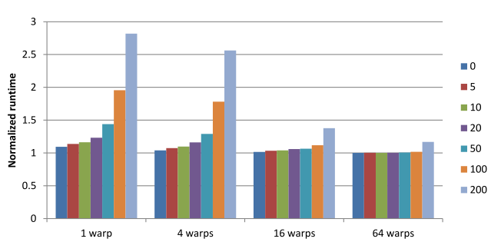
Harder in a GPU
Need to ensure effect-free rollback
No hardware buffering
Idempotent regions and CDs
Tradeoffs with hardware buffering and detection latency

Slide 47
Express correctness intent
curCD-> RegisterDetection(errors_reported);
Notifies auto-tuner of detection capability
Enables error elision
curCD->RequireErrorProbability( error_type, num_errors, probability,detect_or_fail_over);
Auto- add redundancy to meet requested level of reliability
curCD->GetErrorProbability( error_type, num_errors);
Customize action

Slide 48
Analogues to approximate computing research
Compiler techniques for approximate computing
Propagate loss of accuracy
Propagate loss of reliability

Slide 49
Debug, test, and tools
Error and failure injection
Planned integration with low-level injection
CD profiler, viz, models, and initial tuner in place

Slide 50
Quick(ish) way to search the error space
Multi-mode simulation
Skip over detectable errors
Tool to be released
Uses only public tools

Slide 52
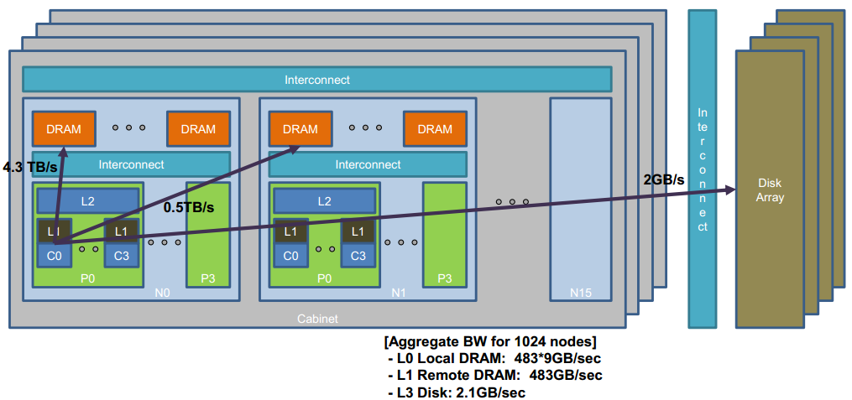
Machine and error models
Component | “Performance” | Error | Error Scaling
Core | 10GFLOP/core | Soft error | ∝ #cores
Memory | 1GB/core | ECC fail | ∝ #DRAM chips
Socket | 200GB/s /socket | Hard/OS crash | ∝ #sockets
System | Hierarchical network | Power module or network | ∝ #modules and #cabinets
Notes:
We made this basic machine to different scales. We fixed performance and memory capacity per core. We varied the network bandwidth depending on the degrees of hierarchies we have in the machines.
Constant Fit rate for soft errors per core, memory errors per DRAM chip, system level failures per socket, and Power network failure per power distribution model.
-------------------------------------------------
Theoretical machines.
Mattan: Missing figure for system. That’s also the place to say weak scaling.
A Monte Carlo approach to the simulation of neutron transport is desirable because the creation and simulation of every particle is independent, making the problem embarrassingly parallel.
HPCCG is a linear system solver that uses the
conjugate gradient method and can scale to a large number
of nodes
How we came up with the machines. (how we scaled)
Theoretical machines.
Mention containment domain we selected was based on auto tuning.
From these workloads we extracted containment domain structures and tuned it with our tools. (preservation intervals… and stuffs)
-----------------------
Picture of the system.
Swimlanes. Big core style small core style.

Slide 53
Input 1: machine configuration
Physical and storage hierarchies (capacity and BW)
Error/failure rates at each level of hierarchy
Simple power model
Input 2: application description
CD tree, including loops of CDs
Preservation volumes and possible method
Overlap of preservation and detection with parent
Execution time estimate
Analytic model for CD behavior
Overheads from preservation, detection, and recovery
Output efficiency
Performance, energy, memory

Slide 54
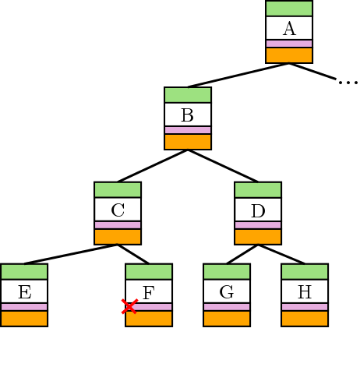
Error Failure Recovery

Slide 55
Analytic Model
Leverage hierarchy and CD semantics
Uncoordinated “local” actions
Solve in → out
Application abstracted to CDs
CD tree
Volumes of preservation, computation, and communication
Preservation and recovery options per CD
Machine model
Storage hierarchy
Communication hierarchy
Bandwidths and capacities
Error processes and rates
Execution time
Notes:
Main Points: Abstraction made capturing existing resilience techniques and semantics of containment domain made analysis easy.
- Error rates would be sum of multiple error sources.
- Erroneous data never communicated -> we can evaluate one domain with children at a time. -> Go up to root -> you get the expected execution time.
Duration, error rate, hierarchy -> expected execution time.
One level at a time -> Recursively go to root.

Slide 56
Power model
CDs that are not re-executing may remain idle
Actively executing a CD has a relative power of 1
A node that is idling consumes a relative power of $α$
In our experiments $α=0.25$
Parallel domains
Re-execution time
Idle
Idle
Idle
Idle
Idle
Idle
Idle
Idle
Idle
Idle
Idle
Idle
Idle
Idle
Idle
Idle
Execution
Re-execution
Notes:
Added first order power model that takes into account nodes that are idle while waiting for other nodes to recover.
Power model can be improved with additional mapping information.

Slide 57
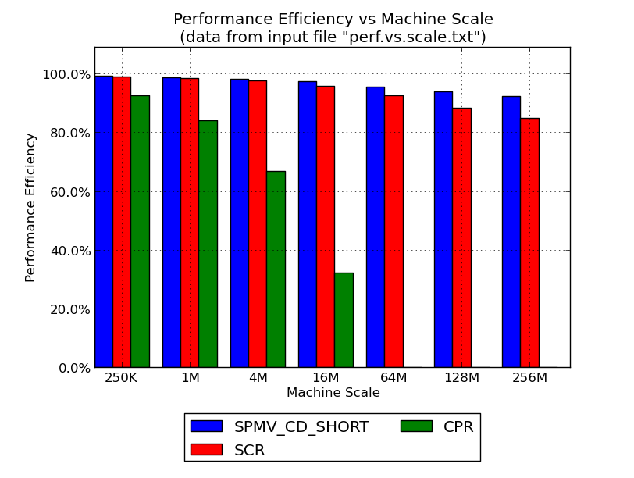
SPMD-oriented analytical model and tuner
Extrapolated profile
Machine characteristics
Tuning space and models

Slide 58
Auto-tuned cross-layer resilience!
Iterate with error injection
Intelligent search exploration

Slide 59
Execution model progress
Building systems is hard and tricky
Limited release of single-node runtime
MPI runtime very close
Lots of distributed programming issues
Lots of current sad state of FT issues
Open source soon on Bitbucket
Initially only for soft errors

Slide 60
Already useful and collaborations in progress
Reaching down to hardware in FF2
Global address space with DEGAS
Task-based execution in Legion and SWARM
DSL-facing in Stanford’s PSAAP II
Algorithmic approach within TOORSES

Slide 61
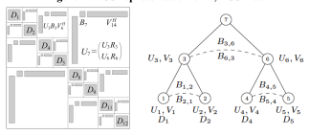
TOORSES fault-tolerant hierarchical solver
Brian Austin, Eric Roman, and Xiaoye (Sherry) Li LBNL
Hierarchical semi-separable representation

Slide 62
Add CDs at different granularities
Hierarchical and partial preservation
Add algorithmic and cheap detection
Compare to:
Algorithmic recovery with redundant computation

Slide 63
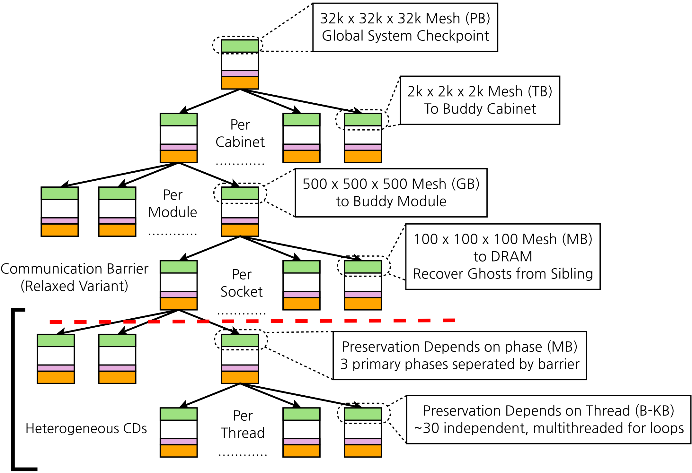
LULESH CD mapping example

Slide 64
Autotuned CDs perform well
NT
SpMV
HPCCG
Peak System Performance
Notes:
Mention initial results are very promising.
Why we chose 50% 80% and all that.
Show that there are three application
Mention clear bar. Mention what bars mean. Talk about legends (performance efficiency and energy overhead)
Add slides
Machine model
And error model.
--------------------------------
H-CPR is the name we used .. Like SCR
CDs can express h-cpr and we validated results with SCR paper.
Highlight 50% line.
Separate energy and performance
NT does very well because why it does well.
SpMV we only do partial preservation. That’s why it is doing well.
Question will be asked.
Why NT does well why Spmv does well. Explain it.

Slide 65
CDs improve energy efficiency at scale
NT
SpMV
HPCCG
Peak System Performance
Notes:
What is the energy overhead?
Energy overhead is an overhead for preservation restoration and re-execution.

Slide 66
10X failure rate emphasizes CD benefits
Energy Overhead
Peak Performance
Notes:
If error rate is higher CDs become much more improtant.
Say
Paper includes other sensetivity
Mattan: Same as above about characteristics – reinforce your points.
Correct the legend
The reason why we experimented with higher rate. (scalability or? High altitude? )
Machine model.
Mention why we did 10x failure rate.

Slide 67
What if my application has many barriers?
Can’t really form a tree?

Slide 68
SPMV: local recovery and partial preservation
Disk
Remote NVM
Local NVM
DRAM
Partial preservation via sibling or parent where appropriate
Notes:
This one for the most part is similar to a scalable checkpoint restart we still have the advantage of some aspects of partial preservation because we can preserve some things with that are already preserved in the parent or with the natural redundancy.
Mainpoint: Point is that these span a range of behavior. Not comprehensive, but still a range
After strengths slids, give example how the mini apps were analyzable. (pick one application)
A Monte Carlo approach to the simulation of neutron transport is desirable because the creation and simulation of every particle is independent, making the problem embarrassingly parallel.
HPCCG is a linear system solver that uses the
conjugate gradient method and can scale to a large number
of nodes
How we came up with the machines. (how we scaled)
Theoretical machines.
Mention containment domain we selected was based on auto tuning.
From these workloads we extracted containment domain structures and tuned it with our tools. (preservation intervals… and stuffs)
Synthetic application of
Each CDs annotated with
Mention it matches with SCR paper.
Mention everything is tuned with our tools (optimum interval)
Mantevo

Slide 69
Inter-CD communication?
Strict CDs do not communicate
Only communicate when in same CD context
Overheads for strict containment can be high
Relaxed CDs enable inter-CD communication
Maintain CD semantics w/ uncoordinated recovery
Some data “preserved” via logging
All communicated data still verified to be correct
Outer CDs
Inner CDs
Sync+ comm

Slide 70
SPMV: local recovery and partial preservation
Disk
Remote NVM
Local NVM
Relaxed CDs
DRAM
Partial preservation via sibling or parent where appropriate
Notes:
This one for the most part is similar to a scalable checkpoint restart we still have the advantage of some aspects of partial preservation because we can preserve some things with that are already preserved in the parent or with the natural redundancy.
Mainpoint: Point is that these span a range of behavior. Not comprehensive, but still a range
After strengths slids, give example how the mini apps were analyzable. (pick one application)
A Monte Carlo approach to the simulation of neutron transport is desirable because the creation and simulation of every particle is independent, making the problem embarrassingly parallel.
HPCCG is a linear system solver that uses the
conjugate gradient method and can scale to a large number
of nodes
How we came up with the machines. (how we scaled)
Theoretical machines.
Mention containment domain we selected was based on auto tuning.
From these workloads we extracted containment domain structures and tuned it with our tools. (preservation intervals… and stuffs)
Synthetic application of
Each CDs annotated with
Mention it matches with SCR paper.
Mention everything is tuned with our tools (optimum interval)
Mantevo

Slide 71
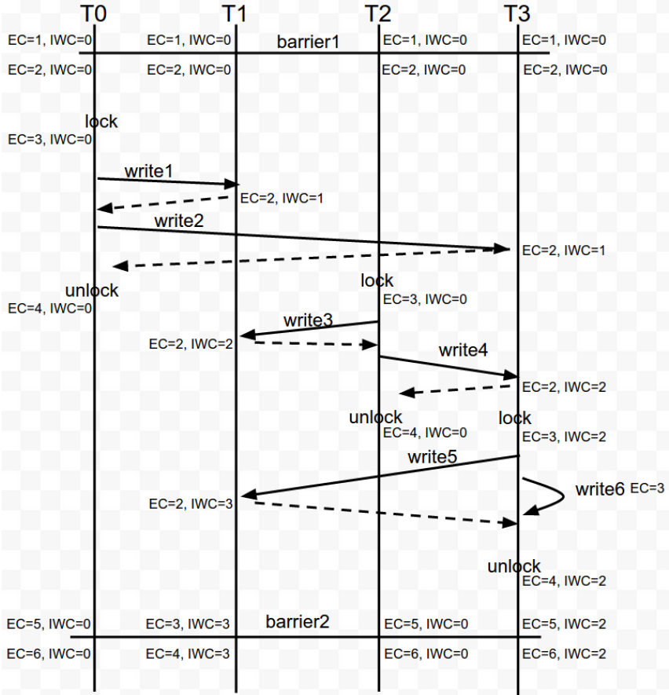
Fun with logging protocols

Slide 72
What about tasks?
CDs are great natural fit
CDs + Legion
Stanford project led by Alex Aiken
CDs + Swarm
Spinoff from UDel led by Guang Gao
Perhaps also with *SS / Nachos
Barcelona Supercomputing Centers

Slide 73
Legion resilience
Propagate failures up the dependence chain
Utilize region copies to minimize reexecutions

Slide 74
Legion + CDs resilience
Model-guided management of copies
Optimized reexecution propagation stop points
Detection and specification semantics
Integration with other resilience mechanisms

Slide 75
Use Legion copies for CD preservation
Optimize for efficiency
When to add copies
Where to put copies to survive failures
When to free copies
Account for different failure modes and rates

Slide 76
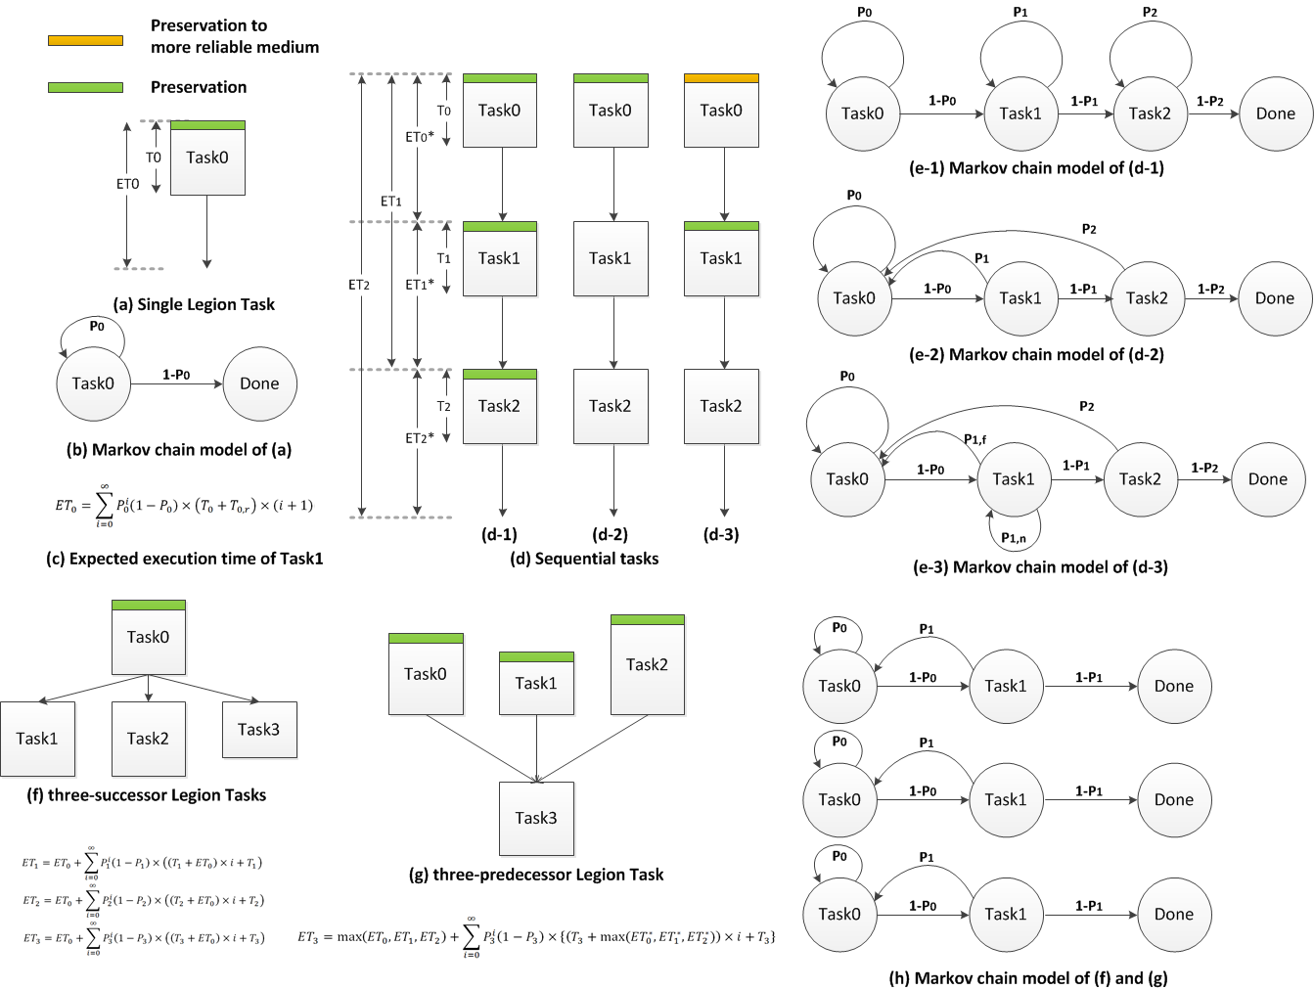

Slide 77
Assumption/fear: reliability bounds performance
Errors may corrupt results and failures kill applications
What is the error rate?
Like today: keep ignoring the problem
Much higher: need detection and recovery
CDs abstract, scalable, and tunable
What is the failure rate?
Like today: hierarchical checkpoint restart
Higher: specialize preservation and recovery
CDs are portable and tunable
Is it really a problem?
CDs are general and analyzable
CDs are composable?

Slide 78
Conclusion
Containment domains
Abstract constructs for resilience concerns & techniques
Proportional and application/machine tuned resilience
Hierarchical & distributed preservation, and recovery
Analyzable and amendable to automatic optimization
Scalable with high relative energy efficiency
Heterogeneous to match emerging architecture
http://lph.ece.utexas.edu/public/CDs
Notes:
Containment domains are abstract constructs for resilience concerns and techniques.
Containment domains are proportional and application and machine tuned resilience.
Containment domains provide hierarchical and distributed preservation, restoration and recovery.
Containment domains are analyzable and amendable to automatic optimization.
Containment domains are scalable to large system with high relative energy efficiency.
Containment domains match emerging heterogeneous architecture.

Slide 79
Thank You!
Please find the slides at https://lph.ece.utexas.edu/merez/MattanErez/ExacaleResilienceShort0715

